Slide 1
Finding a
The Tools

Slide 2
Search Tools
State Employment Agency
Specific Agencies, Organizations or Stores
Employment Agencies
Flyers or Signs
Friends and Family
Social Media
Newspaper Classified
Cold Calls

Slide 3
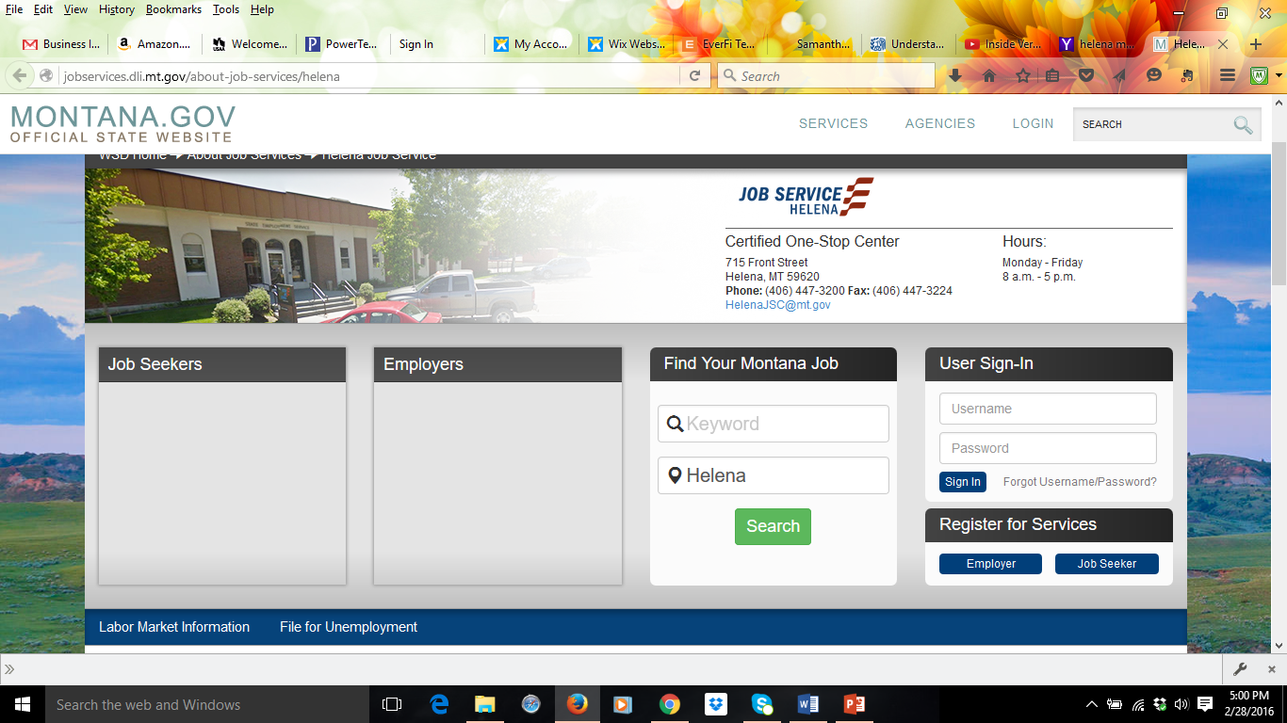
State Employment Agency – Montana Job Service
Free | Online and Office
Customizable Job Search | Search anywhere in Montana
Professional and Skilled Counselors Available to help | Can get specific job recommendations and apply online with an account

Slide 4
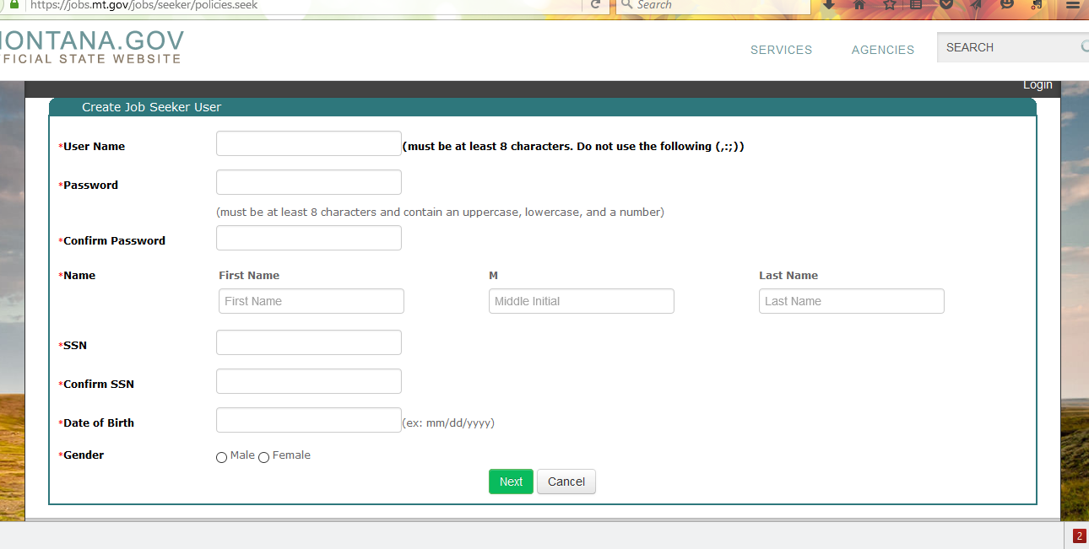

Slide 5
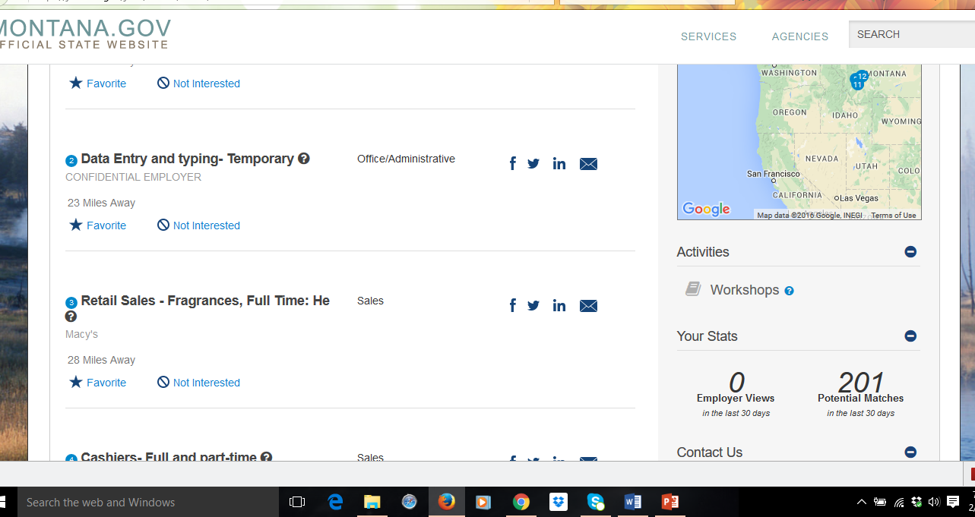

Slide 6
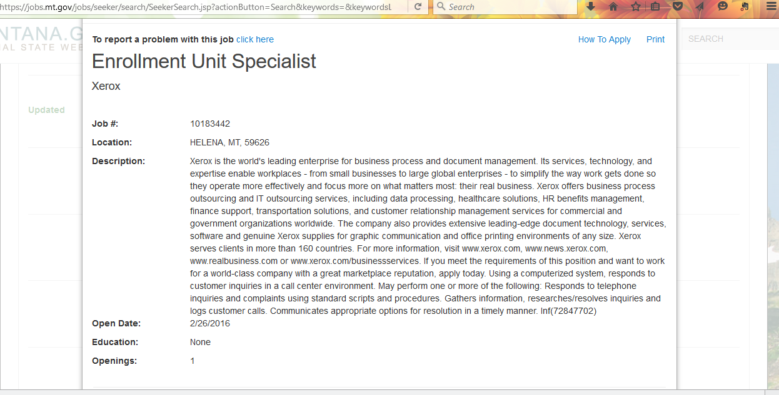

Slide 7
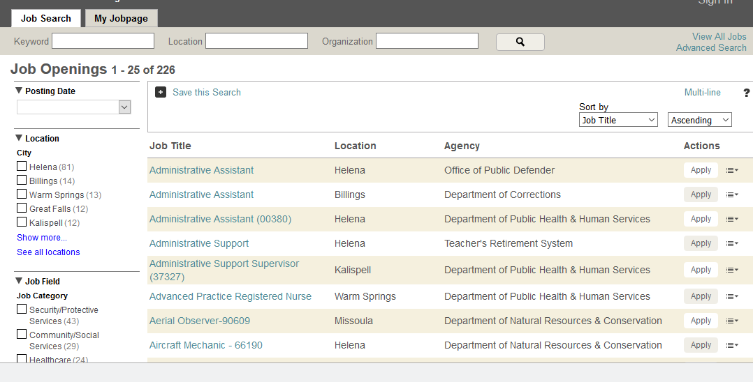
Agencies (State of Montana Jobs)
http://statecareers.mt.gov/

Slide 8
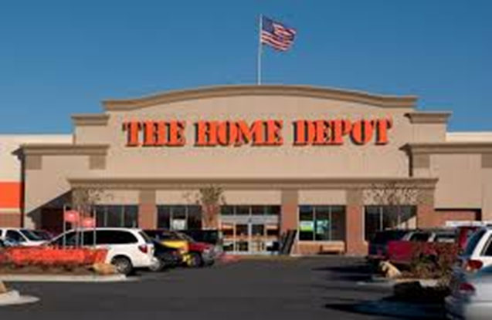
Another tool…Agency, Organization or Company Websites
Most nationwide corporations (McDonald’s, Wendy’s, Safeway, Albertsons, Home Depot, Lowes) and many large organizations like the Helena School District all have websites where position vacancies are advertised.
Job search options
Require online applications (usually)

Slide 9
Organization – Federal Government Jobs
www.usajobs.gov

Slide 10
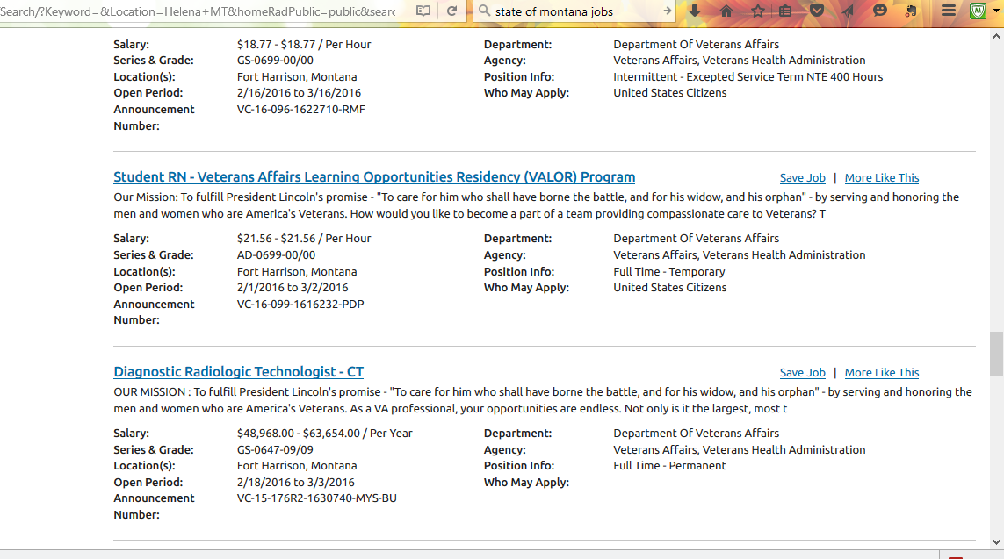

Slide 11
Employment Agencies
www.westaffmt.com
http://www.a2zmontana.com/
Online Employment Agencies

Slide 12
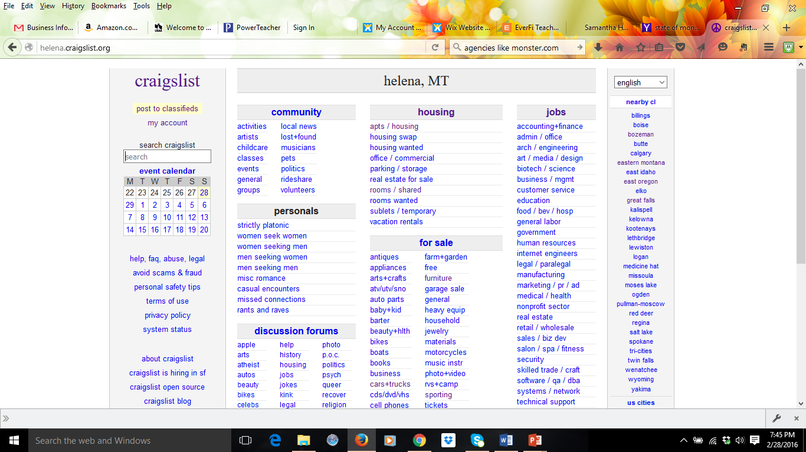

Slide 13
Social Media
Newspaper

Slide 14
Cold Calls
From Investopedia: Cold calling typically refers to phone calls but can also entail drop-in visits (or even emails or letters)
Directed at companies you are interested in working for but do not know if a vacancy exists.

