Slide 1
A Place of Your Own
Renting versus Owning

Slide 2
How much can you afford?
All too often, people look for a place and THEN determine what they can afford to pay.
25-35% of income = Max for housing
Includes Rent/House Payment + Utilities + Insurance

Slide 3
What are Utilities?
Electricity
Gas/Propane
Water
Trash
Internet
Cable or Satellite

Slide 4
What to find rentals:

Slide 5
What the ads are saying….
DW
LR
RM
BA
DR
G/D
BR

Slide 6
What the ads are saying….
3 BR Apt for RENT - $1200/mo
Renov 3 BR apt w/ 2 BA. Newer Appls. W/D and
Dw. in unit. H/W floors. WIC in Master BR.
Det Gar. Great city Vw. Large back yd.
First & Last + $500 Deposit

Slide 7
Know what you’re getting in to
Month to Month Rental Agreement – You can terminate the contract and move out without penalty with 30 days notice
Lease – Cannot be terminated unless the lease expires or both parties agree.

Slide 8
What is the deposit for?
To protect the landlord is the tenant
Causes damage, OR
Doe not complete all required cleaning, OR
Owes unpaid rent or utilities.

Slide 9
How to be sure you get the deposit back
Thoroughly check out the place and take pictures
Read the contract
Keep the place clean and repair any damages you cause
Notify your landlord if a repair is necessary (they have 14 days to fix it)
Pay your rent & utilities on time
Provide adequate notice when moving out
Allow enough time to clean thoroughly or hire someone

Slide 10
At the time the landlord and tenant enter the rental agreement, the landlord must provide the tenant with a written statement of the condition of the property, signed by the landlord. If the landlord does not provide such a statement, the landlord may not keep any part of the tenant’s security deposit for damages when the tenant moves out, unless the landlord can clearly prove that the tenant caused the damage. (Montana Residential Landlord and Tenant Act)

Slide 11
30 Days – Amount of time landlord has to return you security deposit less any deductions that must be documented.

Slide 12
Other Questions??
Montana Codes Annotated
Department of Justice

Slide 14
Roommates Can be A Nightmare
“My roommate in the dorms wore a puppet on her shoulder and if you asked her a question she would answer with the puppet. It was a puppet of a griffin, which is a mythological creature that’s a combination of lion and eagle. It sucked. We also had all the same classes together and I woke up late more than once to that damn puppet in my face telling me the time.” —Kate Edwards

Slide 15
Roommates Can be A Nightmare
Had a roommate whose room stank like nothing else. I could even smell it from the hallway as I passed his closed door. It was like being smacked in the face by a wall of cheese.
I figured it was BO or perhaps the ethnic foods he ate, so I didn’t say anything to avoid sounding rude.
Well, he left 2 months later and a new roommate moved in. Upon cleaning the room, we discover he hadn’t thrown out the garbage the entire time he was there! He just kept all the rotting trash in a wooden chest and overflowing garbage bins.
Not only that, he washed his laundry once every 6 weeks or so, which undoubtedly contributed to the rank smell.

Slide 16
Well, he left 2 months later and a new roommate moved in. Upon cleaning the room, we discover he hadn’t thrown out the garbage the entire time he was there! He just kept all the rotting trash in a wooden chest and overflowing garbage bins.
Not only that, he washed his laundry once every 6 weeks or so, which undoubtedly contributed to the rank smell.

Slide 17
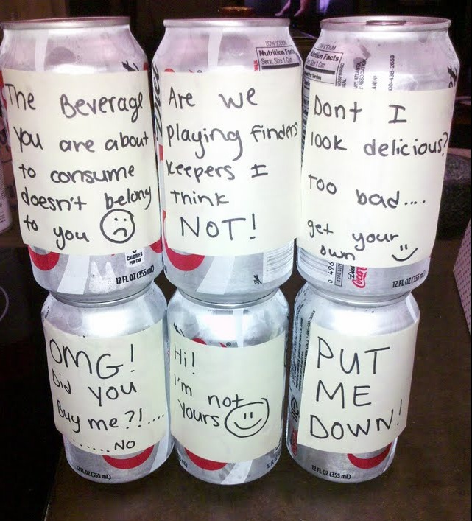
Roommates Can be A Nightmare
My roommate has been straight up eating my food and even drinking my pop, which is both annoying and starting to take a financial toll

Slide 18
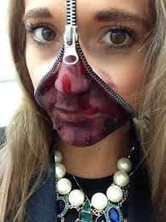
Roommates Can be A Nightmare
Don’t pay their rent
Use your things
Don’t respect your privacy
Refuse to clean up after themselves
Have overnight guests
Play terrible music too loud or are just too loud in general
Or are just weird…..

Slide 19
The Case for a contract

Slide 20
Important Elements of a Roommate Contract
Names, Landlord, Rental Address
Signature and Dates
Quiet Hours
How rent is split; when it is due; who is responsible for the actual payment
How utilities are split, when they are due and who is responsible for the actual payment
What happens if one roommate can’t pay their share?
How damages will be handled or repaired
What happens if someone moves out?
Cleaning responsibities and schedules

Slide 21
Important Elements of a Roommate Contract
Guest Policy (Including over night)
Rules for anything shared (TV, fridge, microwave, etc.)
Allergy/Emergency Information
Pets
Party Guidelines
Parking
Food
Steps for resolving disagreements
What can you borrow/take from each other? Food? Clothes?

