Slide 1
Employment
How does the pay part work?

Slide 3
Job versus Career
Usually Hourly and Scheduled by the Hour
Limited or no experience
Can be long term or short
Can become a career
Usually Full time and usually requires work experience and post secondary education
Can stay forever but usually involves continual growth and goals

Slide 4
Job versus Career
If hired as manager and meet certain requirements – may not get overtime
Usually Hourly and Scheduled by the Hour
Limited or no experience
Can be long term or short
Can become a career
40 Hours/week or 2080 hours per year = Full Time
Over 40 hrs = OT
Usually Full time and usually requires work experience and post secondary education
Can stay forever but usually involves continual growth and goals.
Generally receive a salary

Slide 5
Ways to Get Paid
Hourly | Agreed Upon Rate x Hours worked | Minimum Wage – least amount a business can pay per hour (Varies from state to state; there is a federal minimum wage)
Overtime | Any hours over 40 in one week | Paid at 1.5 (time and a half) x hours of 40 and added to your 40 hour paycheck
Salary | Agreed upon Salary – usually work 40 hours per week but not always paid overtime (depending on management status) | Paid at agreed salary amount each month or an annual rate/12 months

Slide 6
Ways to Get Paid
Commission | Used for Sales type jobs (usually get an hourly rate or salary + a percentage of sales) | Paid at agreed wage + % of total sales less returns or as agreed Sometimes there is no base salary just a % of sales
Piece Rate | Used for production | Paid at an agreed amount * the number of items produced

Slide 7
Pay Period Calculations
Pay Period | Hourly | Salary | Commission
Weekly | Number of hours * hourly rate + (overtime hours * 1.5) | Annual Amount/52 (weeks in a year) | Sales in one week less returns * commission rate
Bi-Weekly (Every 2 weeks) | Number of hours in 2 week period * hourly rate + (overtime hours IF over 80 * 1.5) | Annual Amount /26 | Sales in two week less returns * commission rate
Bi-Monthly – (getting paid twice monthly) | Number of hours in pay period * hourly rate + (overtime hours IF over 80 * 1.5) | Annual Amount/24 | Sales in pay period less returns * commission rate
Monthly | Rarely done for hourly but it would be total hours in the month * hourly rate | Annual Amount/12 | Monthly sales less returns * commission rate

Slide 8
Another way to make money….
Become an Entrepreneur…
From Forbes.com..
Consider the following two definitions of “entrepreneur”: one found in Merriam-Webster’s dictionary, the other from Dictionary.com.
Merriam-Webster: “one who organizes, manages and assumes the risks of a business or enterprise.”
Dictionary.com: “a person who organizes and manages any enterprise, especially a business, usually with considerable initiative and risk.”
…..You own your own business or are in a partnership with other people.

Slide 9
How Entrepreneurs get paid
They give themselves a salary either weekly, monthly or annually and take that regardless of the success of the business
They take a percentage of the weekly/monthly/annual profit of the business
They pay themselves and take a percentage of the profits
They take “draws” from the business and count that toward their pay (not always a great idea)
Or another method that might work best for them.

Slide 10
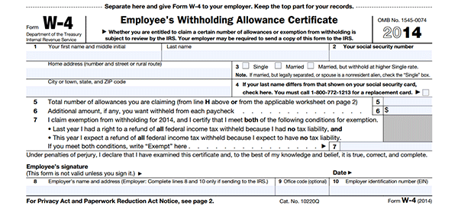
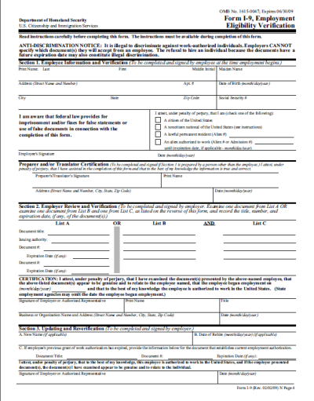
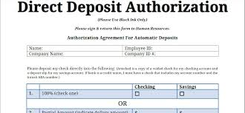
Forms needed to get paid

Slide 11
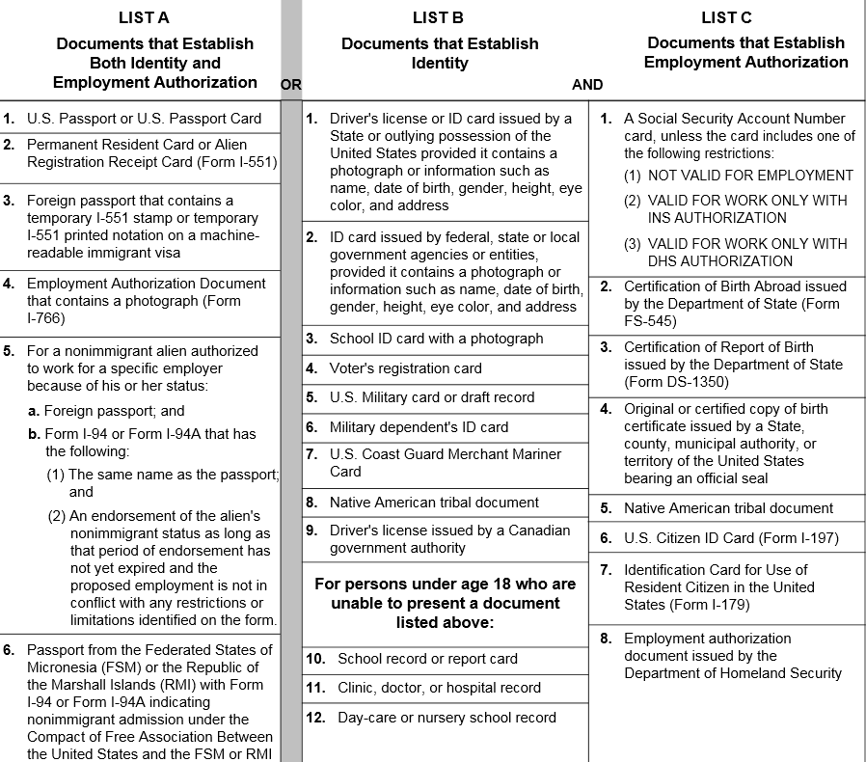
I-9

Slide 12
W-4 Declare your Withholding

Slide 13
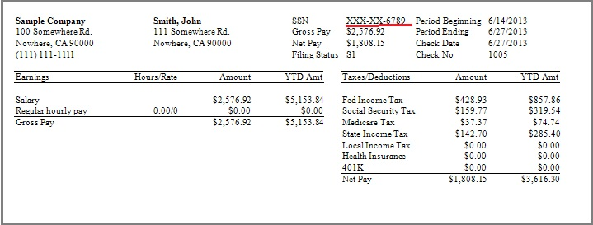
Getting Paid
Direct Deposit
Paycheck
Payroll Card

Slide 14
Understanding Your Paycheck

