Slide 1
Home Ownership Terms

Slide 2
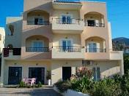
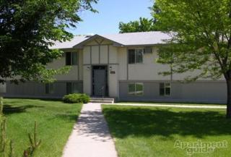
Apartments

Slide 3
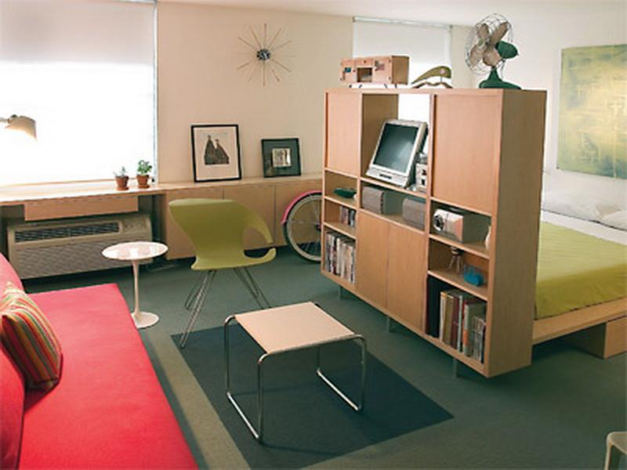
Studio

Slide 4
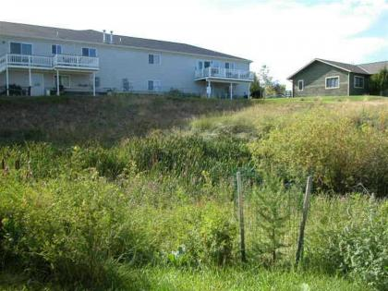

Slide 5
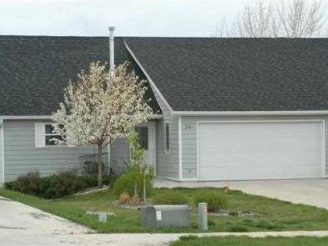
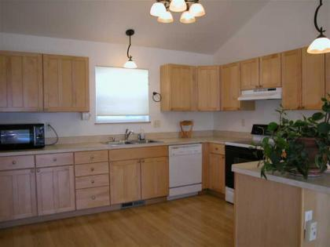
Townhouse

Slide 6
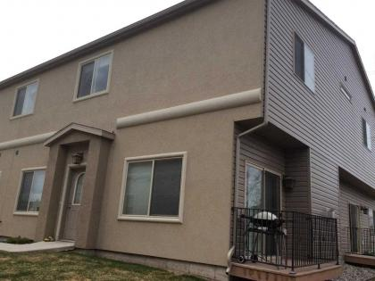
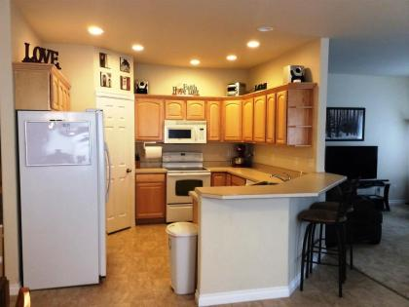
Condominium

Slide 7
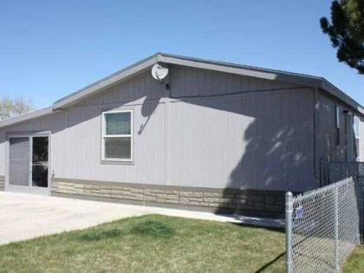
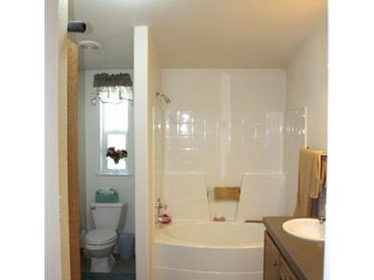
Mobile Home

Slide 8
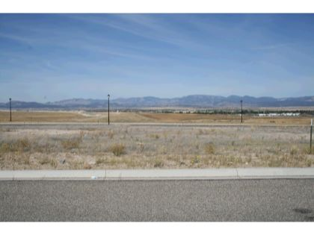
Raw Land

Slide 9
 | Bank | Credit Union
Owned by | Banks are owned by shareholders. | A Credit Union is owned by its members, who are depositors of money in the institution.
Profit motive | Banks aim to make a profit for share holders. | Credit unions are not for profit. Any money left over after expenses and reserves is passed back to customers (members) in the form of lower fees, lower loan rates, higher deposit yields and free services.
Types | Commercial bank, community bank, community development banks, savings bank, postal savings bank and private banks | Consumer credit unions & corporate credit unions.
History | Letters of credit used in the 3rd century. Muslims used banking services in the 9th century. 12th century archeological finds include cheques. | Credit unions are relatively newer as compared to banks because the earliest known evidence of their existence dates back to 1852.

Slide 10
Payments | Yearly Total | Principal Paid | Interest Paid | Balance
Year 1 (1-12) | $14,777.21 | $2,343.59 | $12,433.62 | $197,656.41
Year 2 (13-24) | $14,777.21 | $2,494.34 | $12,282.88 | $195,162.07
Year 3 (25-36) | $14,777.21 | $2,654.78 | $12,122.44 | $192,507.30
Year 4 (37-48) | $14,777.21 | $2,825.54 | $11,951.68 | $189,681.76
Year 5 (49-60) | $14,777.21 | $3,007.28 | $11,769.93 | $186,674.48
Year 6 (61-72) | $14,777.21 | $3,200.71 | $11,576.50 | $183,473.77
Year 7 (73-84) | $14,777.21 | $3,406.59 | $11,370.62 | $180,067.18
Year 8 (85-96) | $14,777.21 | $3,625.71 | $11,151.51 | $176,441.48
Year 9 (97-108) | $14,777.21 | $3,858.92 | $10,918.29 | $172,582.56
Year 10 (109-120) | $14,777.21 | $4,107.13 | $10,670.08 | $168,475.43
Year 11 (121-132) | $14,777.21 | $4,371.31 | $10,405.90 | $164,104.12
Year 12 (133-144) | $14,777.21 | $4,652.48 | $10,124.73 | $159,451.64
Year 13 (145-156) | $14,777.21 | $4,951.74 | $9,825.48 | $154,499.90
Year 14 (157-168) | $14,777.21 | $5,270.24 | $9,506.97 | $149,229.66
Year 15 (169-180) | $14,777.21 | $5,609.23 | $9,167.98 | $143,620.43

Slide 11
Payments | Yearly Total | Principal Paid | Interest Paid | Balance
Year 16 (181-192) | $14,777.21 | $5,970.03 | $8,807.19 | $137,650.40
Year 17 (193-204) | $14,777.21 | $6,354.03 | $8,423.18 | $131,296.37
Year 18 (205-216) | $14,777.21 | $6,762.73 | $8,014.48 | $124,533.64
Year 19 (217-228) | $14,777.21 | $7,197.72 | $7,579.49 | $117,335.91
Year 20 (229-240) | $14,777.21 | $7,660.70 | $7,116.52 | $109,675.22
Year 21 (241-252) | $14,777.21 | $8,153.45 | $6,623.77 | $101,521.77
Year 22 (253-264) | $14,777.21 | $8,677.89 | $6,099.32 | $92,843.88
Year 23 (265-276) | $14,777.21 | $9,236.07 | $5,541.15 | $83,607.81
Year 24 (277-288) | $14,777.21 | $9,830.15 | $4,947.06 | $73,777.67
Year 25 (289-300) | $14,777.21 | $10,462.44 | $4,314.77 | $63,315.23

Slide 12
Payments | Yearly Total | Principal Paid | Interest Paid | Balance
Year 26 (301-312) | $14,777.21 | $11,135.40 | $3,641.81 | $52,179.82
Year 27 (313-324) | $14,777.21 | $11,851.65 | $2,925.56 | $40,328.17
Year 28 (325-336) | $14,777.21 | $12,613.97 | $2,163.24 | $27,714.20
Year 29 (337-348) | $14,777.21 | $13,425.33 | $1,351.89 | $14,288.87
Year 30 (349-360) | $14,777.21 | $14,288.87 | $488.34 | $0.00
Totals | $443,316.38 | $200,000.00 | $243,316.38

Slide 13
Reverse Mortgage

Slide 14
20%

Slide 15
On a $200,000 loan, each point would cost $2,000
Assuming the interest rate on the mortgage is 5% and each point lowers the interest rate by 0.25%
Buying 2 points will cost $4,000 and will result in an interest rate of 4.50%

Slide 17
Buy/sell Agreement

Slide 18
the structure
the common safety devices
the basement and crawlspaces
the central heating
the central cooling
the plumbing system
the bathroom
the laundry
the electrical system
the kitchen
the fireplace
the building exterior
the attic and ventilation
the insulation
the roof
Radon Gas levels (sometimes)
the grounds
the parking areas
and much more
Inspections

Slide 19
Lender's origination fee
Deposit verification fees
Attorney's fees
The appraisal fee and any inspection fees
Cost of title insurance and title examination
Document preparation (by a third party)
Property survey
Credit reports (actual costs)
Transfer stamps, recording fees (at the county)
Taxes
Insurance
Test and certification fees
Home inspection fees up to $200
Closing Costs

Slide 20
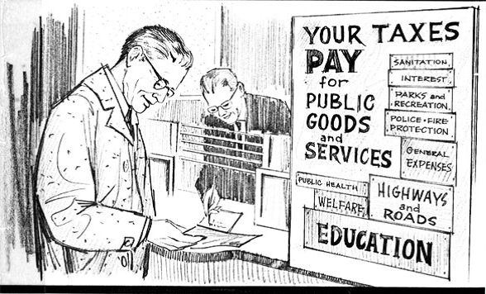
Escrow Account

