Slide 1
RESUMES that get RESULTS
John Smith
I rock!

Slide 2
What is a resume? Believe it or not, its so NOT about you….
Its a written response
That demonstrates to an employer or recruiter that you have what they need.
Its about the recruiter’s needs.
It’s a tailored marketing document.

Slide 3
Helpful Hints for Writing Modern Résumés
Responds to the job posting
SELL Yourself By Matching
Your skills to their needs
keywords and Industry buzzwords are … key

Slide 4
HOW DO MODeRN RESUMeS dIFFer FROM THE OLD ONES?
OLD Generic Looks like it came from a template Usually no color or image | NEW Customized for each job Breaks traditional rules Uses Color and Logo

Slide 5
Obviously your objective is to get a job or find a full time job or find a career….it is not necessary to tell an employer
No need to summarize your “qualifications”…instead you list applicable skills FOR THE JOB YOU ARE APPLYING FOR
Boring…. And too much information that doesn’t matter….if a class or something you did is applicable to the job – you will list it under skills or in a way that gets noticed!

Slide 6
Employment and volunteer work should highlight what you have done that meets the needs of the job you are applying for
You activities and personal interests/achievements don’t really matter to an employer….unless they meet the employer’s needs and that can be listed under skills or highlighted in a headline or another means to get noticed.
This does not go last but first and should be in a table format; bulleted with key words THAT RELATE TO THE JOB YOU ARE APPLYING FOR

Slide 7
Tailor your Résumé for each job
Be of a kind

Slide 8
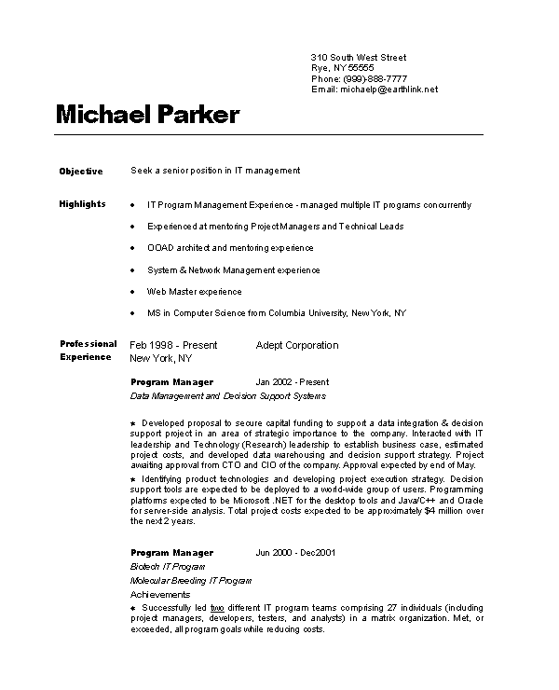
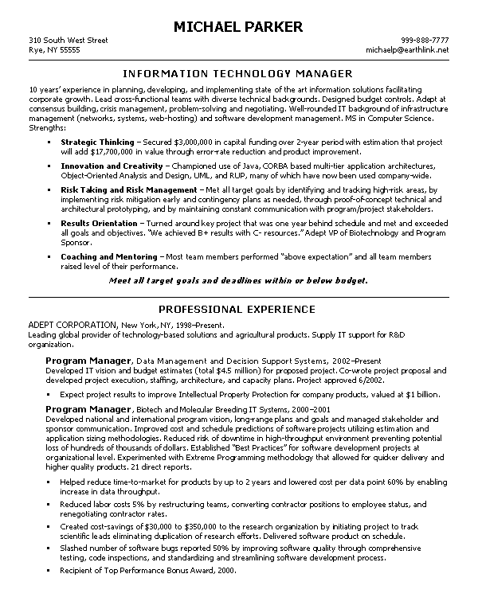
BEFORE (template) AFTER (tailored)
↑ Uses headline, stair-step style, bold & brag with keywords, drops months, years on right, and merges 2 jobs in 1 place.

Slide 9
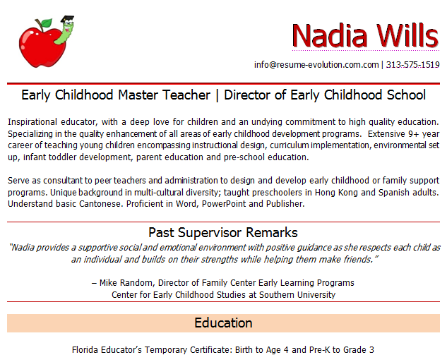
Contemporary résumé for an Early Childhood Teacher
Is your résumé contemporary or old-school?
Color and clip art
or Logo
Address omitted
Double ‘Headline’
‘Career Summary’
Or Skills Section
Testimonial (quote)
Education Bottom-loaded

Slide 10
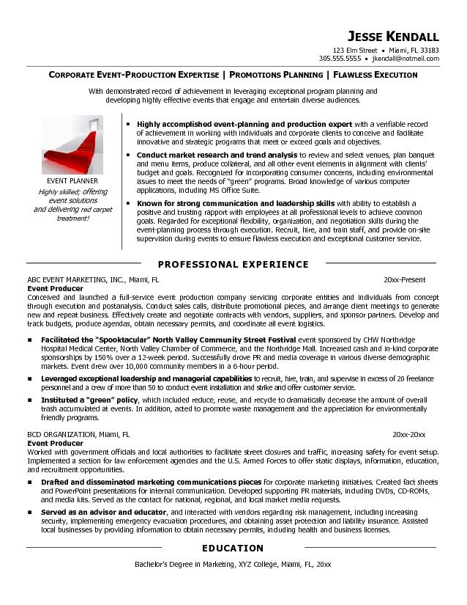
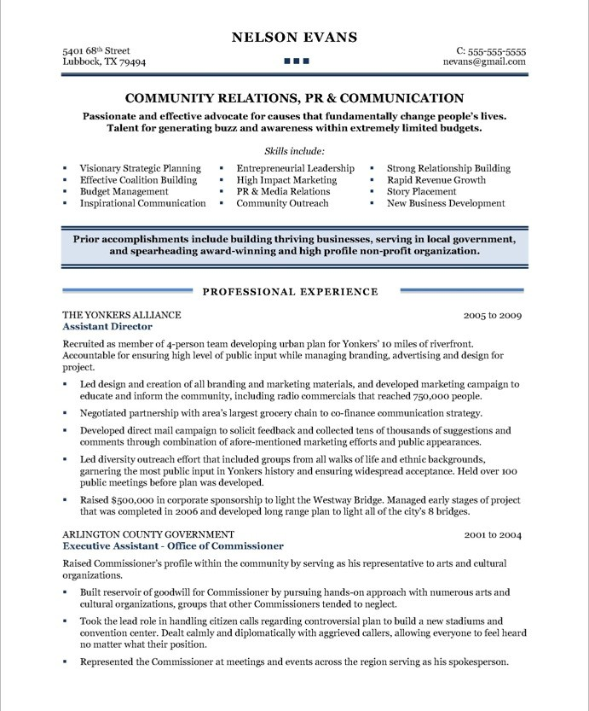
Examples
These are NOT templates; they were crafted using Word and strategically tailored to a job.

Slide 11
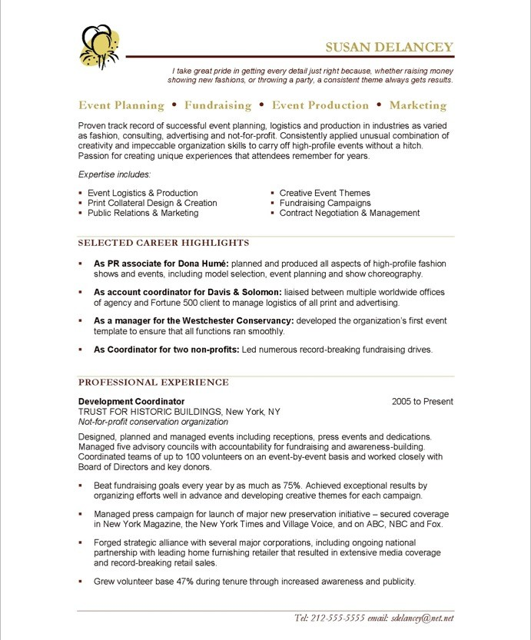
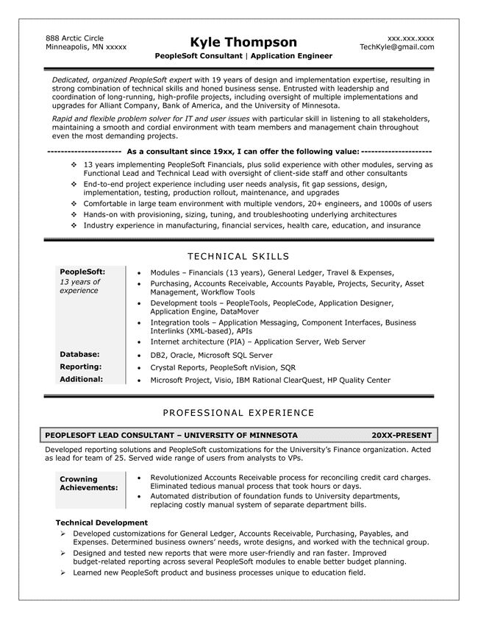

Slide 12
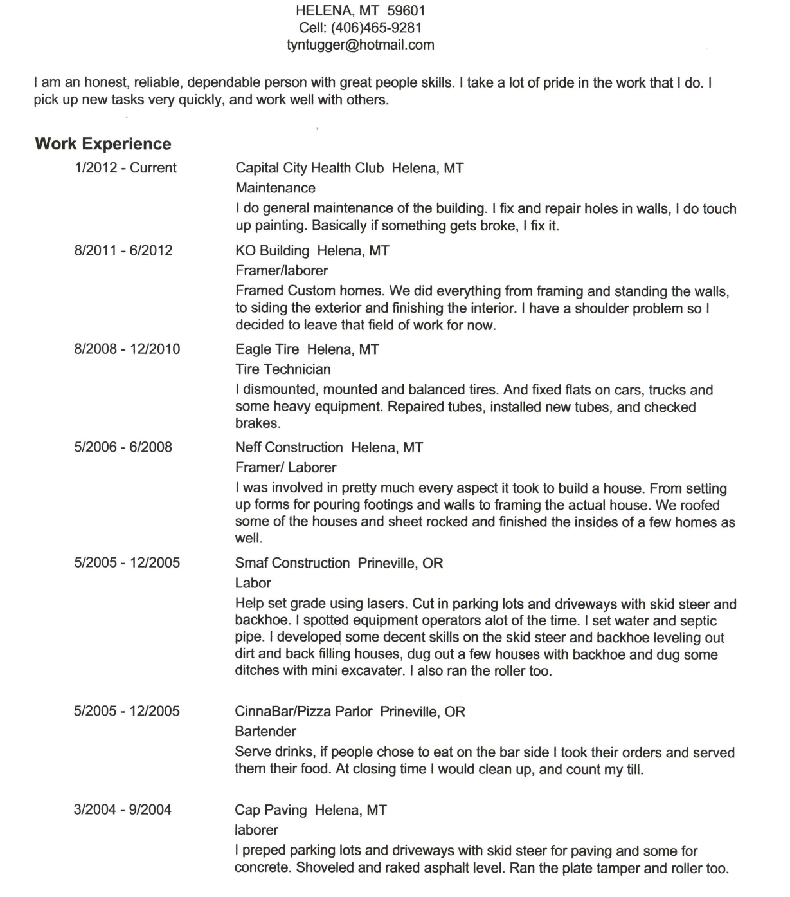
Original résumé
Sam Jones.
Close your eyes -- when you open them, read Sam’s résumé and count to 6.25 seconds.
That is the time a recruiter takes to decide if his résumé goes in the
“yes” or “no” pile.
Help the recruiter
What does he do?
What are his skills? education?
How many years’ experience?
Any certifications?
What equipment can he run?
OOPS! Six seconds are up!

Slide 13
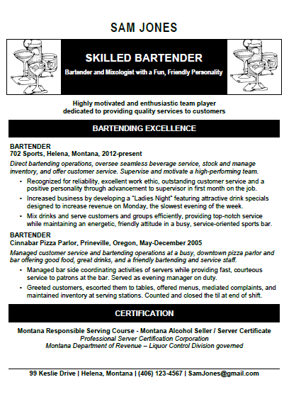
Let’s Update it!!
What job are you applying for?
Personal attributes or skills appropriate for the job!
Creative way to say “Work History” or “Employment History”
Work history using key words or words employer relate to the goals of a business
What applicable education do you have?

Slide 14
Start at the Top with … the letterhead
But, remember … there are no ‘rules”.

Slide 15
Privacy & SAFETY Identity theft and personal security economic profiling Eliminated from consideration due to estimated $ they anticipate you will expect so you can continue to live in your neighborhood or in the manner you are accustomed to living. Interview / Relocation Costs Eliminated or included in recruitment due to geography SAVE SPACE Gives résumé more white space to add skills and experience Who CARES? Seriously, does anyone really care what your mailing address is? Probably only about what city you live in. If you get the job, give them your address.
Denise Grant Eager to relocate and travel
406.243.5678 • Dgrant@gmail.com
WHY?
Street Address
is now
Optional

Slide 16
Denise Grant – barista 123 Main Street  Missoula MT 59801  406.243.2345  dgrant@gmail.com DENISE GRANT Missoula, Montana ⎮ (406) 234-4567 ⎮ dgrant@gmail.com Denise Grant __________________________________________________________________________________________________ 406.243.2345  dgrant@gmail.com
Letterhead
Ideas
DENISE GRANT  ▪ 
123 Main Street (406) 234-4567
Missoula Montana dgrant@gmail.com
DENISE GRANT
MBA relocating to Denver, Colorado
________________________________________________________________________
(406) 234-4567 dgrant@gmail.com

Slide 17
How do you create a letterhead?
Decide if you want to create your own logo or use a royalty free image as a logo to represent you.
What’s a logo?
Thing of the Nike Swoosh, the McDonald’s M, Apple’s Apple.
Click here for some logo games
If you want to create your own logo – here’s some ideas

Slide 18
Then “Just Do It” - Create a letterhead
You can use:
A blank page in Word and create your own
Use a template in Word (although they can sometimes be difficult to use when typing)
Use a template your teacher might provide
To really get creative, check out this video.
Be sure to save your completed work as “Letterhead”
How do you create a letterhead?

Slide 19
Ok – Now create your personal letterhead
But, remember … there are no ‘rules”.

Slide 20
Next ..
Organize your personal information
Get it all together:
Work history – including babysitting; mowing lawns; raking leaves; etc.
Be sure to have complete addresses, phone numbers and who to contact
Write down details of each of your duties at each job
Volunteer work
Be detailed about all of the activities and duties you performed
Leadership positions – what did you lead and what did you do?
Sports activities – Captain position? Team work? Time management?
Awards and certifications
References-ASK FIRST!!! List Name and phone number – have at least 3

Slide 21
Next ..
Your References
More about References
VIDEO & Article
Other things to remember:
Ask if you can use a person as a reference first
Use professionals, teachers, pastors, other people who can speak to your work ethic and personal attributes.
DO NOT use family members or friends or someone who might not give you a good reference

Slide 22
Next ..
Your References
More about References
VIDEO & Article
Other things to remember:
Ask if you can use a person as a reference first
Use professionals, teachers, pastors, other people who can speak to your work ethic and personal attributes.
DO NOT use family members or friends or someone who might not give you a good reference

Slide 23
Putting it all together
Using Key Words and Your Skills to Customize

Slide 24
Step 1: Open the job announcemeNt

Slide 25
Step 2: Highlight the KEYWORDS

Slide 26
Step 3: Matching KEYWORDS with Skills
KEYWORDS | How to list a skill that relates:
breakfast/lunch restaurant 6:30am - 2:30pm | *Morning Person (don’t put this if you are not a morning person…)
Host/Bus/Cashier | This is the job title
greeting and seating customers: (This requires good customer service skills and the ability to find out what someone needs and where they would like to sit and then direct them there. You most likely would also get them water and tell them who their wait person is.) | *Greet Customers (who can’t say “hello” and “welcome to our restaurant”?) *Determine/Take Customers’ Needs Orders *Direct customers to table *Ensure customers have menus and water

Slide 27
busing tables: This involves doing a good job cleaning tables by clearing dishes and disinfecting while wiping down the table, make sure salt/pepper/sugar are clean and ready for the next customer as well as reset the table | *Clearing tables (don’t you do this at home or when babysitting?) *Disinfecting tables and condiment containers *Proper Table Setting
picking up the floor | *Vacuuming *Cleaning with a variety of tools (Can you sweep? Vacuum? Pick things up with your hands?
taking to-go-orders | *Determine/Take Customers’ Needs Orders (You already listed this so it doesn’t need to be listed twice)

Slide 28
serving as cashier | *Operate cash register (If you can) *Money Counting *Make Change (if you can)
Experience with POS (POS stands for Point of Sale for credit and debit cards) | *Operate POS (if you can)
Host/Hostess | *Enjoy people *Customer Service Oriented
professional appearance (No visible tattoos or visible piercing.) | *Professional Appearance (but not if you have visible tattoos or piercings you don’t plan on removing)

Slide 29
Putting it all together
Lets Make the
Resume

Slide 30
Remember….

Slide 31
Resume Writing TIPS Revisited Set a Strategy Use Keywords Templates don’t hold up against tailored resumes Modify resume for the job or industry – your audience Clearly, concisely convey your value DO NOT USE: “Responsibilities included” and “I” statements Quantify when or if possible ($, #, %)
Do
What
Works

Slide 32
Seeking Career Transition to Bank Teller Honor Roll High School Senior Seeking Server Position
Headlines
- ~ -
Taglines
- ~ -
Career Statements
Firefighter
Dive Rescue | Technical Rescue | Hazardous Materials | Airport Rescue
Skilled, OSHA Certified Construction Laborer
Fitness and Wellness Assistant
Training in sports, fitness, health and wellness training and education
Senior Sales Manager Operations - Marketing - Merchandizing
“Increasing Revenue, Enhancing Profitability and Maximizing Productivity”

Slide 33
Holds BA in Psychology/Chemical Dependency and spent 10 years in pharmaceutical sales AND simultaneously volunteered as a youth counselor. She is burned-out on sales, tired of travel and wants a job working with youth. Let’s write to her future. BEFORE Denise Smith 123 Main Street  Missoula Montana 406.243.2345  dsmith@gmail.com Pharmaceutical SALES MANAGER Ten year multi-national career representing products of three global pharmaceutical industry leaders. Track record of consistent delivery of double-digit revenue and profit growth within highly-competitive healthcare markets. Expertise areas: ☑ Executive Sales Presentations ☑ Price & Contract Negotiations ☑ New Product Introduction ☑ Sales Budgeting and Reporting ☑ Marketing Communications ☑ Territory Management ☑ Sales Training and Mentoring ☑ Business Strategy Design ☑ Client Recruitment &Retention ---------------------------------------------------------------------------------------------------------------------------------- AFTER: WRITTEN TO FUTURE Denise Smith 123 Main Street  Missoula Montana 406.243.2345  dsmith@mail.com youth counselor Ten years’ experience serving in youth-focused community non-profit organizations. Proven ability to provide structure, support, and targeted interventions to help teens learn positive decision making, leading to success in their classrooms, families, and communities. Expertise areas: ☑ Crisis Intervention ☑ Treatment Planning ☑ Psycho-Educational Instructor ☑ Group Facilitation ☑ Parenting Education ☑ Chemical Dependency Trained ☑ Inter-Agency Relations ☑ Conflict Resolution ☑ Community Outreach
Write
to the
Future
not the
past

Slide 34
TELL IT -- ▪ Responsible for operation of automotive sales department customer service. SELL IT -- ▪ Controlled full strategic, operating, and P&L responsibility for daily management of 2000 employees and a two-site customer service operation supporting $25M in sales in FY2012 for the largest U.S. automotive brake manufacturer. ====================================================== TELL IT -- ▪ Managed large-scale reorganization of Kodak’s largest manufacturing plant. SELL IT -- ▪ Spearheaded plant-wide reorganization of Kodak’s flagship manufacturing facility, impacting 1000 staff and generating $450M in sales. ▪ Slashed operating costs 22%, reduced waste 18%, and added $14M to bottom-line profit through implementing lean manufacturing. ====================================================== TELL IT -- ▪ Answered phones. SELL IT -- ▪ Managed 200-line switchboard routing calls to 220 realtors, assisting with sales of commercial, residential, bare land, and investment properties helping to drive revenue to$50M in FY 2012.
Bullets
Tell it
SELL IT!

Slide 35
Bullets are …
Accomplishments | Not Job Duties | Key Skills | Left-loaded | High Impact | Quantified
BEFORE
Responsible for customer service in automotive sales department. (….. this is a duty)
▪ Controlled full management, operations and P&L for 2000 employees in a customer service department driving sales revenues of $250M for a two-site automotive brake manufacturer. (…. one word on one line is an “orphan” - avoid them)
OR ….. left load the bullet …
Drove $250M in sales revenues for a two-site international automotive brake manufacturer through control of management, operations and P&L of a 2000 employee customer service department.

Slide 36
MODERN BULLET STYLE
Job title bold with dates on right, employing stair-step style, using keywords to divide bullets, and showcasing parallel writing (active verbs) and color.
SENIOR ACCOUNT MANAGER
Galaxy Air Lines, Houston, Texas (2008--2012)
Transportation, logistics and supply chain company with 20K clients and 100K employees in 100 countries worldwide doing $420M of business annually.
➢ New Product Development and Brand Management
* Launched products, services and technologies that generated $15M in new revenue.
* Created brand management initiative that monetized $2M in assets.
* Led planning, due diligence and integration of large acquisition ($500M) doubling company size.
➢ Strategic Planning and Leadership
* Partnered with CEO to drive corporate-wide strategic planning, growth, acquisition and initiatives.
* Strategized product and market solutions to ensure competitiveness in the transportation arena.

Slide 37
TOM SMITH 123 ABC Street | Los Angeles, California 59802 | Cell: (714) 456-1234 | Tsmith@gmail.com _______________________________________________________________________ 1 SAFETY & EMERGENCY MANAGEMENT PROFESSIONAL 2 Local ▪ County ▪ State ▪ Federal Agencies 3 Top-performing professional with 20 year’s exemplary achievement in metropolitan law-enforcement .
Résumé Options
1 Headline
2 Tag Lines
3 Career Statement
4 Career Summary
5 Core Competencies
6 Career Highlights
4 Distinguished career in city-wide emergency response and safety management operations. Impressive knowledge of responsibilities and interrelationships between federal, state and local jurisdictions. Success in management of budgets, projects and coordination of critical emergency functions to secure short- and long-term goals. Excellent communicator demonstrating logic, focus and critical thinking while remaining calm in crisis and exercising appropriate delegation of responsibility and authority.
5 Core Competencies:
▪ Homeland Security Directives  Strategic and Tactical Planning
▪ Emergency Preparedness  Fieldwork and Investigations
▪ Anti-Terrorism Threat Analysis  Policies, Programs & Procedures
▪ Budget and Fiscal Management  Government and Media Relations
▪ Human Resources Administration  Infrastructure & Physical Security
_________________________________________________________________________
6 CAREER HIGHLIGHTS
Appointed to homeland security leadership and key law enforcement and position for Los Angeles,
California, serving nearly 10 million residents.
Collaborated with U.S .Secret Service to launch California’s first Gang Crimes Task Force, creating
Homeland Security strategy for state Police Divisions and Emergency 911 Operations .
_________________________________________________________________________
PROFESSIONAL EXPERIENCE

Slide 38
Career Goal: Bank Teller Organized | Personable | Detailed | Thorough ⎯ ▪ ▪ ▪ ⎯ Seeking to employ two years’ administrative support experience to make a career shift to bank teller. Knowledgeable of principles and processes of attentive customer service and honoring confidentiality. Known for a strong work-ethic and working unshaken under pressure. Detailed and thorough in all work tasks including cash handling, reception, and multi-line phone experience.
HEADLINE
4 Taglines
Career Summary
HEADLINE
4 Taglines
Career Summary
HEADLINE
Career Statement
Career Summary
Firefighter _________________________
Dive Rescue | Technical Rescue | Hazardous Materials | Airport Rescue
Proactive personnel and program manager offering 10 years’ firefighting experience. Confident motivator able to focus efforts of diverse groups on a common goal. Committed to providing protection programs that reflect the values, diversity, aspirations, and priorities of the community served.
Certified Fitness and Wellness Professional
Expert in sports, fitness, health and wellness training and education
Energetic, passionate fitness professional dedicated to promoting the benefits of health and wellness. Advanced communication and interpersonal skills with a well-developed ability to motivate others to set and achieve realistic goals. Experience working with college athletes, sports teams, and individuals combining fitness expertise with outstanding customer service, leadership and organizational abilities.

Slide 39
Denise Grant 123 Main Street  Missoula Montana 59801  406.243.2345  dgrant@gmail.com________ Certified Fitness and Wellness Professional Expert in sports, fitness, health and wellness training and education
KEYWORDS
Can be …
Talents
Soft Skills
Experience
Competencies
Energetic, passionate fitness professional dedicated to promoting the benefits of health and wellness. Advanced communication and interpersonal skills with a well-developed ability to motivate others to set and achieve realistic goals. Experience working with college athletes, sports teams and individuals combining fitness expertise with solid customer service, leadership and organizational abilities | Walking Program Fitness Testing Exercise Programs Nutrition Counseling Aerobic Instruction
Denise Grant
406.243.2345  dgrant@gmail.com
Certified Fitness & Wellness Professional Expert in sports, fitness, health and wellness training and education
Energetic, passionate fitness professional dedicated to promoting the benefits of health and wellness. Advanced communication and interpersonal skills with a well-developed ability to motivate others to set and achieve realistic goals. Experience working with college athletes, sports teams and individuals combining fitness expertise with solid customer service, leadership and organizational abilities. Key experience:
Walking Program: Conceived and developed entire walking program, marketing plan, and promotional materials for local mall health and fitness program for retirees.
Fitness Testing: Lead trainer responsible for acquiring new client health history, assessing fitness level, determining personal goals, and leading bi-weekly private counseling session.

Slide 40
DEGREE INCOMPLETE or EXPECTED Studies toward Associate of Arts (A.A.S.) in Computer Science MCSE - Microsoft Certified Systems Engineer, 1997 The Maine College of Technology, 1997-1998 Associate of Arts (in progress - 40 hours completed) Cumulative GPA 4.0 in basic accounting and bookkeeping courses Bachelor of Arts, Japanese - Political Science minor Montana State University, Bozeman, Montana, 2006-2009 (90 credit hours completed; 30 credits remain) University of Montana B.S., Business Administration – Accounting major – Economics minor Expected graduation December 2014
B.A., Biology: Ecology and Evolution majors Montana State University, Bozeman, Montana, 2012
HARVARD UNIVERSITY Bachelor of Arts in Political Science (pre-law), 2011 ‘summa cum laude’ graduate
Education
Heavy-hitter first
Add honors
Add minors / options
Include BA / BS, etc.
Graduation Mo/Yr
Certifications
GPA
Coursework

Slide 41
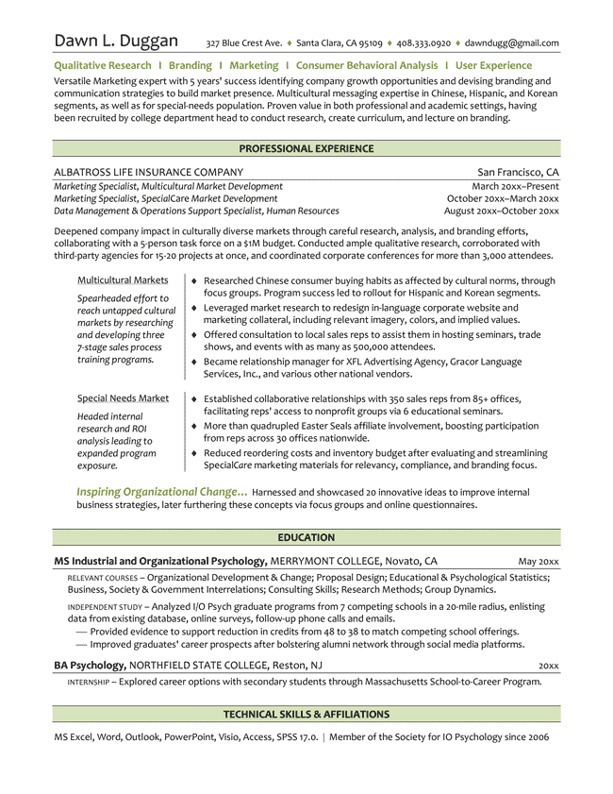
Letterhead →
5 Tag Lines →
Branding Statement →
(aka Career Summary)
Professional Experience
Job Titles (3 jobs same company) →
Job Summary (3 lines) →
Bullets: 2 Column Table →
(accomplishments, not duties)
EDUCATION
Degrees split apart
Relevant coursework added →
Independent Study added →
Bachelors Degree →
Internship added →
TECHNICAL SKILLS & CLUB

Slide 42
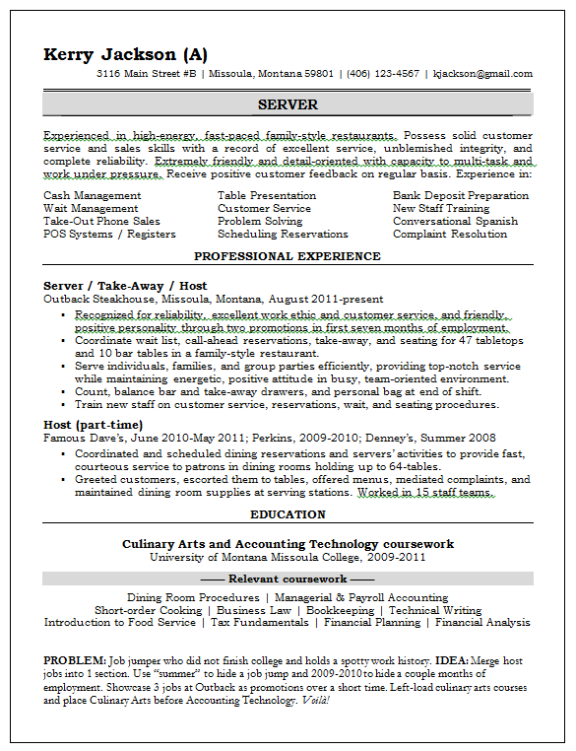
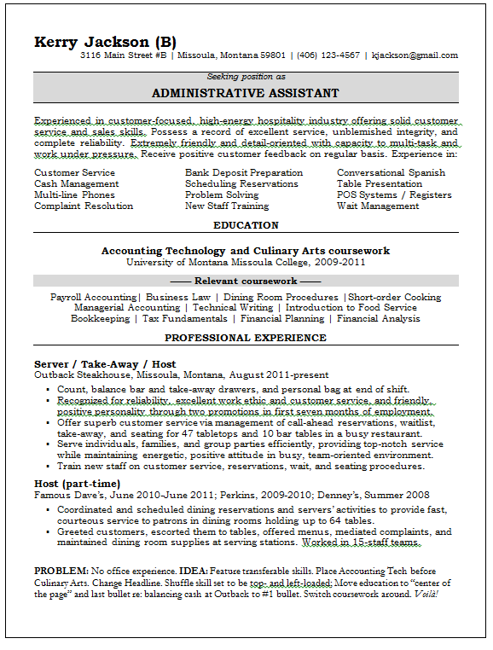
EXAMPLES OF ENTRY LEVEL CUSTOMIZED RESUMES

Slide 43
Headline in Small Caps➢
Career Statement ➢
In a shadowed box
3-Line Career Summary➢
10 Key Skills➢
Highlights Section➢
Testimonial➢

Slide 44
Be One of A Kind, … not one in a million.
Wait a day to proofread, grammar and spell-check it again with fresh eyes.
Use same font, letterhead, and resume paper for all career documents.
Their is no room for even won spelling or grammer error. (gotcha!)

