Slide 1
Finding a
The Tools

Slide 2
Search Tools
State Employment Agency
Specific Agencies, Organizations or Stores
Employment Agencies
Flyers or Signs
Friends and Family
Social Media
Newspaper Classified
Cold Calls

Slide 3
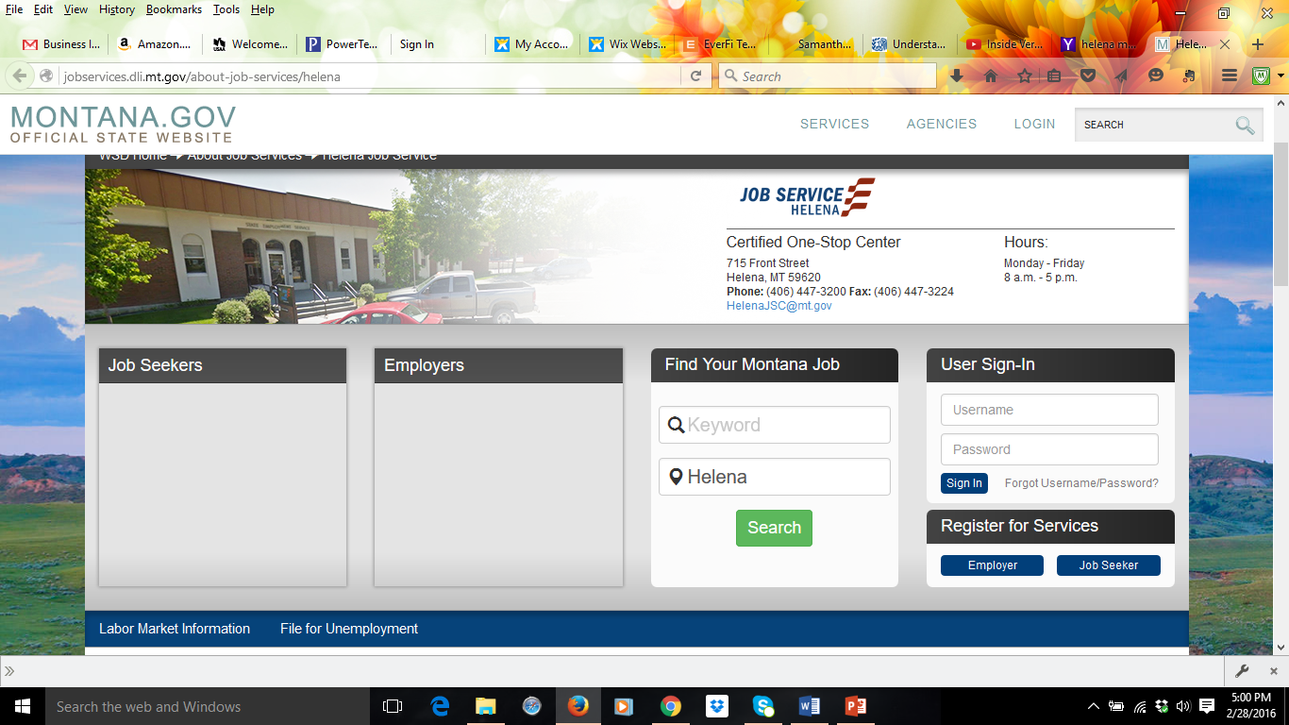
State Employment Agency – Montana Job Service
Free | Online and Office
Customizable Job Search | Search anywhere in Montana
Professional and Skilled Counselors Available to help | Can get specific job recommendations and apply online with an account

Slide 4
Find Your Montana Job

Slide 6
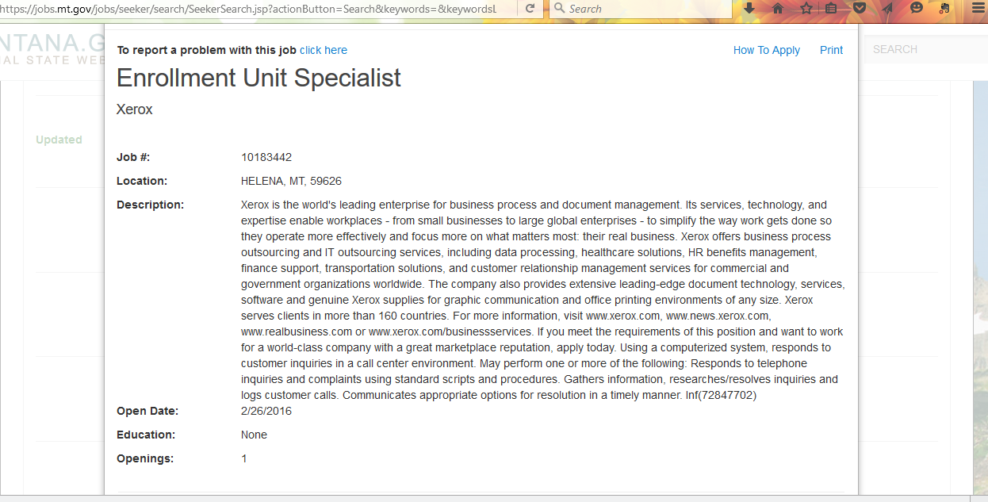

Slide 8
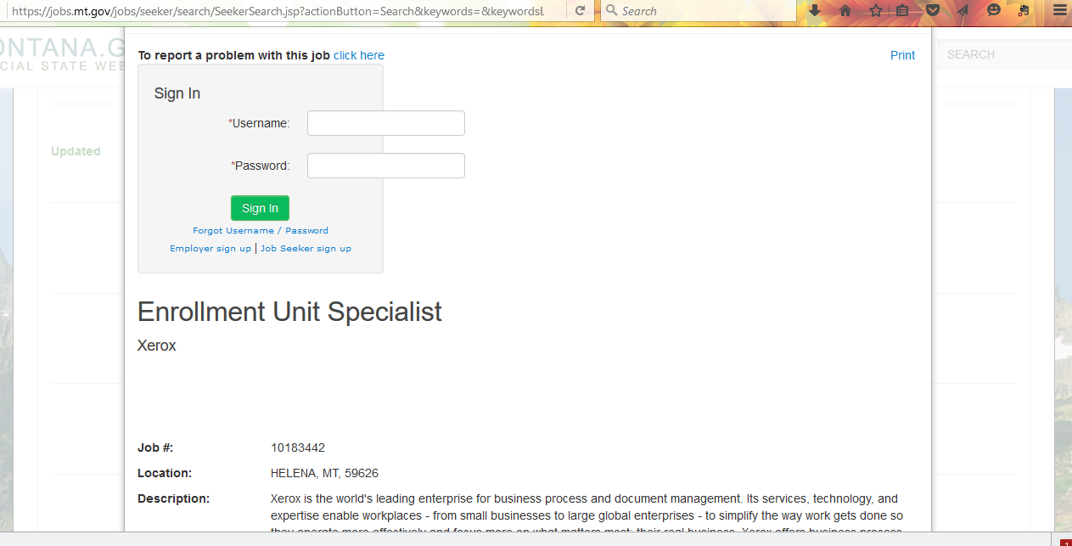

Slide 9
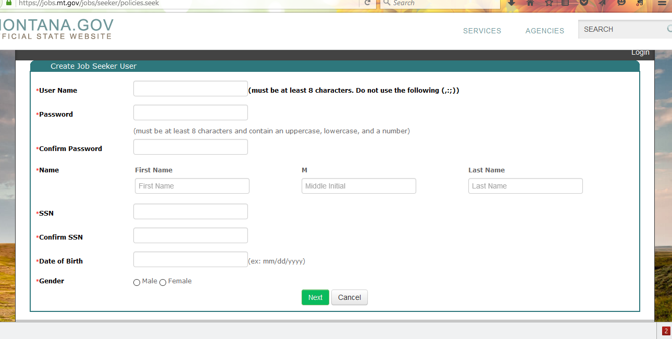

Slide 10
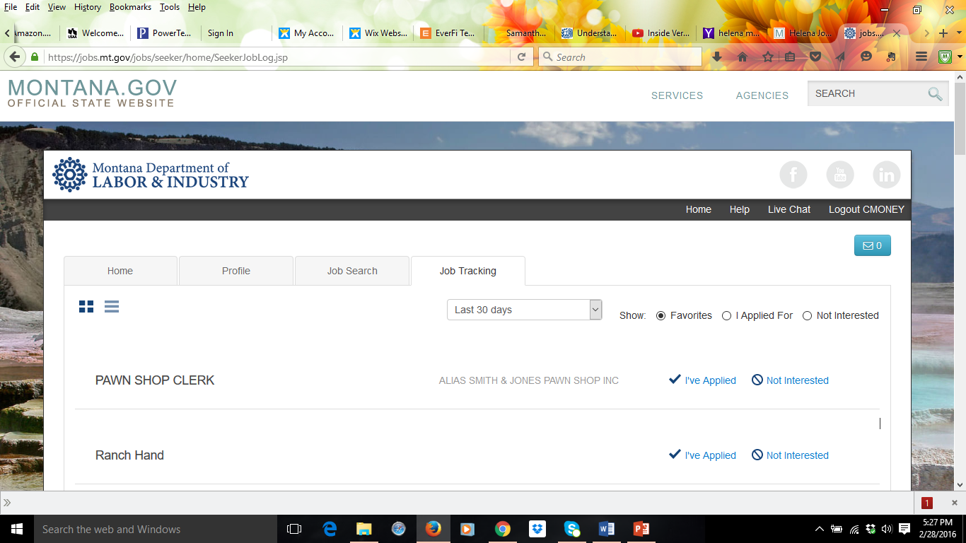

Slide 11
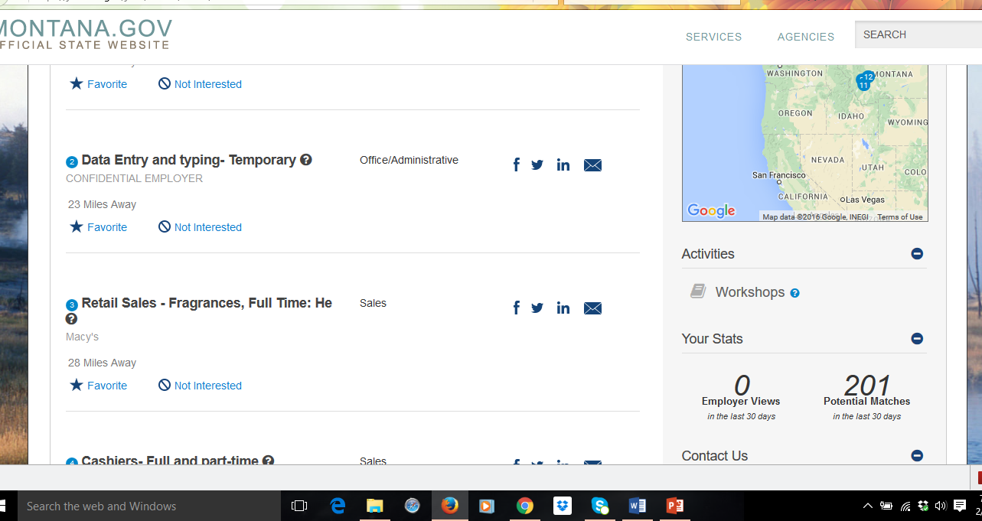

Slide 12
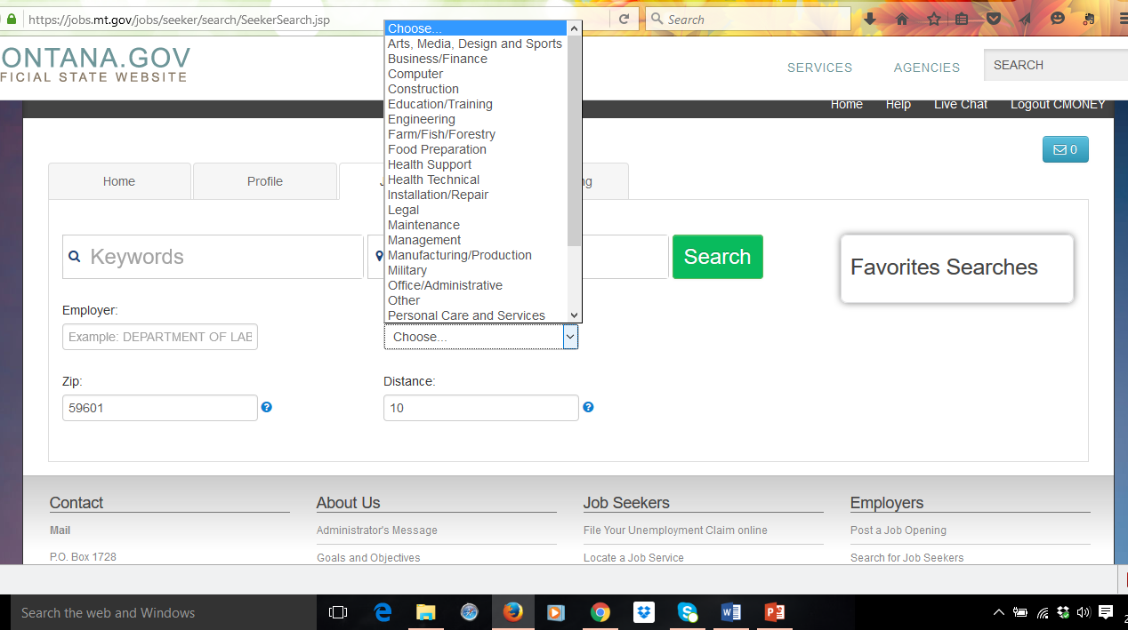

Slide 13
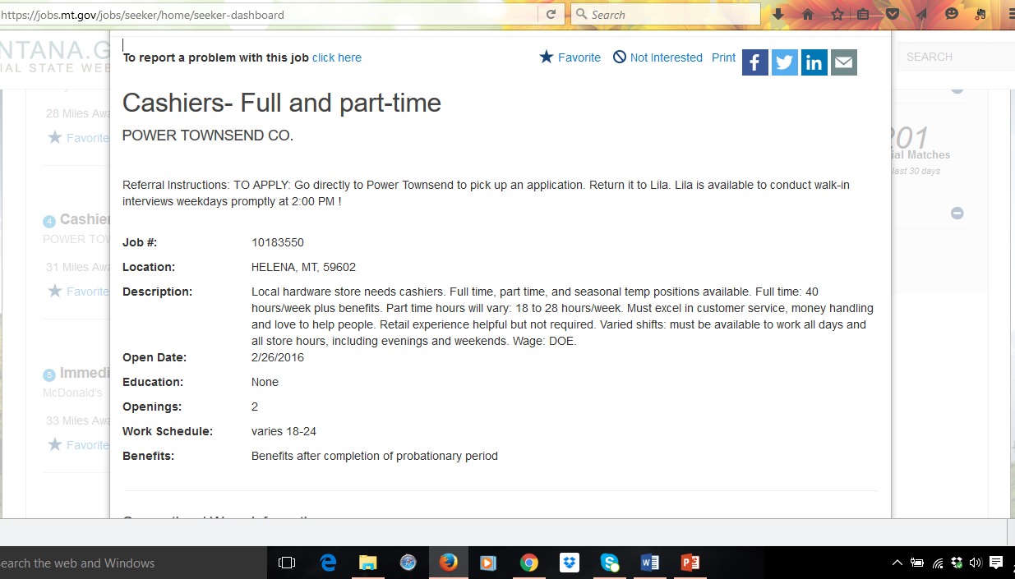

Slide 14
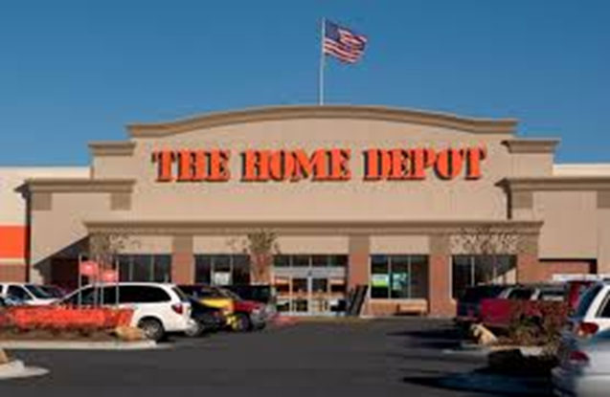
Another tool…Agency, Organization or Company Websites
Most nationwide corporations (McDonald’s, Wendy’s, Safeway, Albertsons, Home Depot, Lowes) and many large organizations like the Helena School District all have websites where position vacancies are advertised.
Job search options
Require online applications (usually)

Slide 16
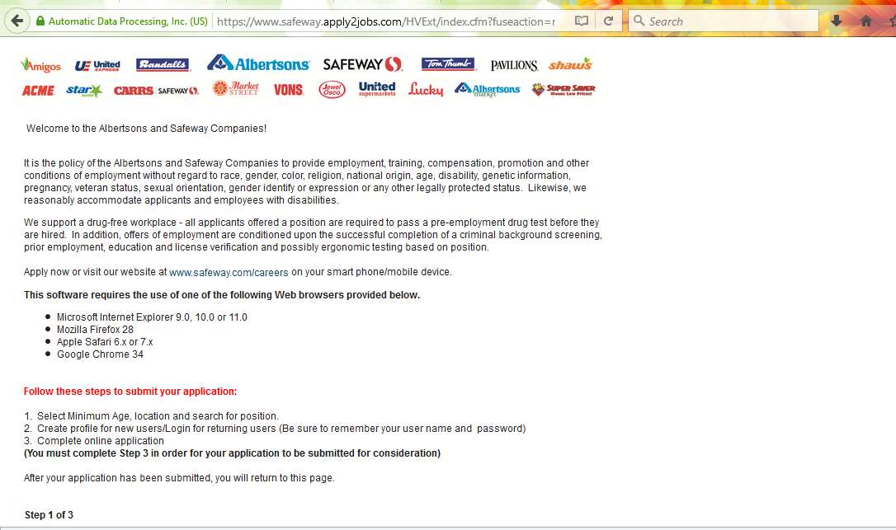

Slide 17
Agencies (State of Montana Jobs)
http://statecareers.mt.gov/

Slide 18
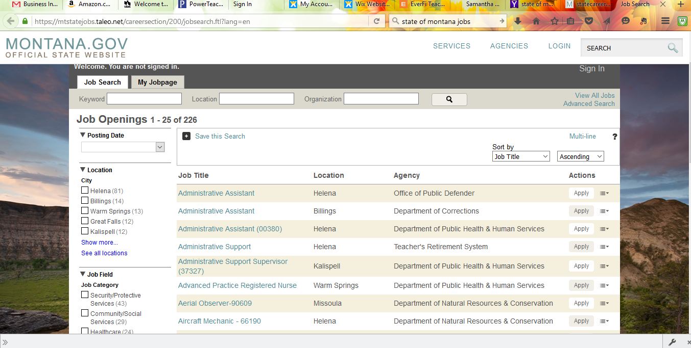

Slide 19
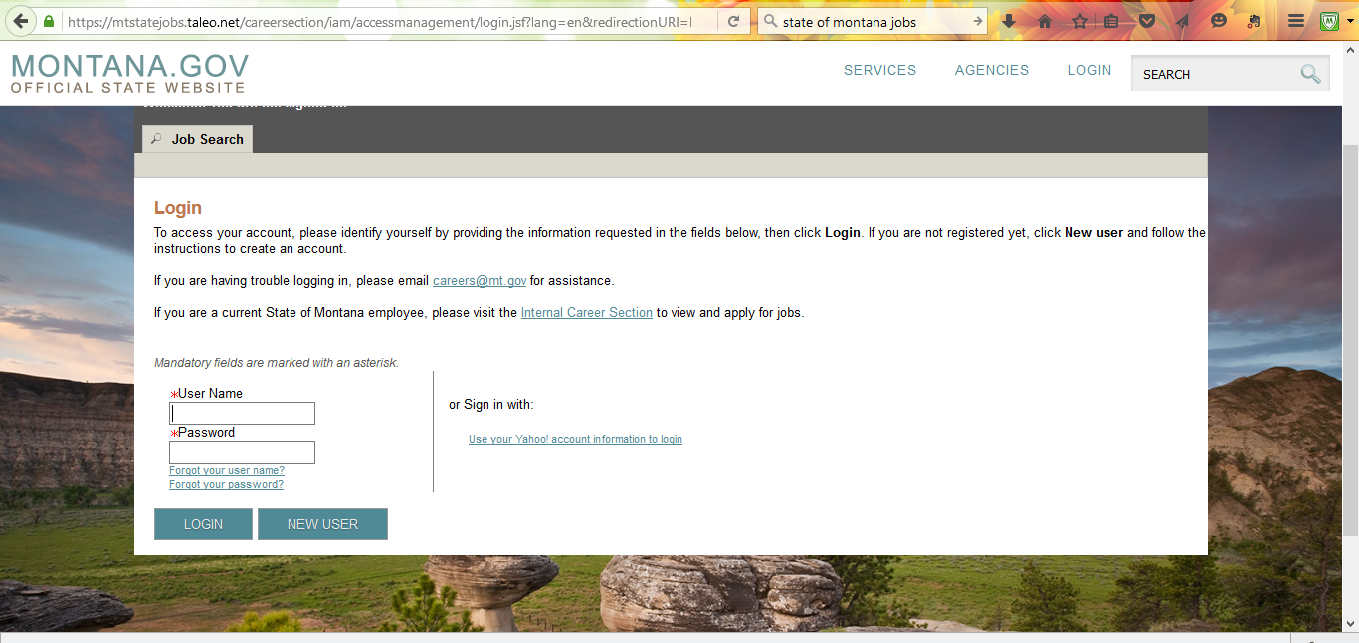

Slide 20
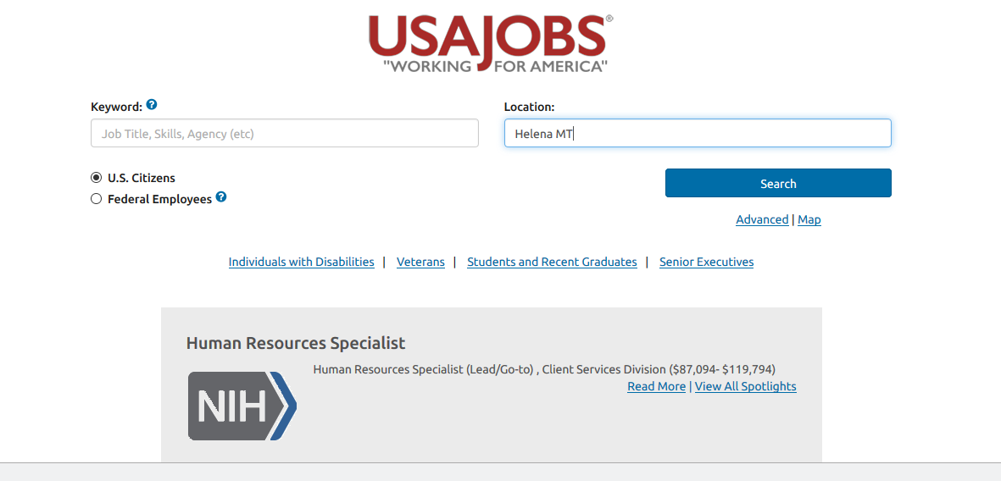
Organization – Federal Government Jobs
www.usajobs.gov

Slide 21
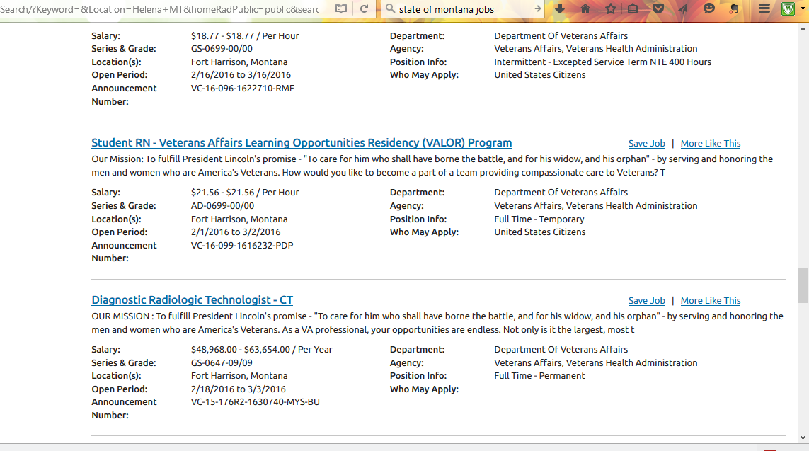

Slide 22
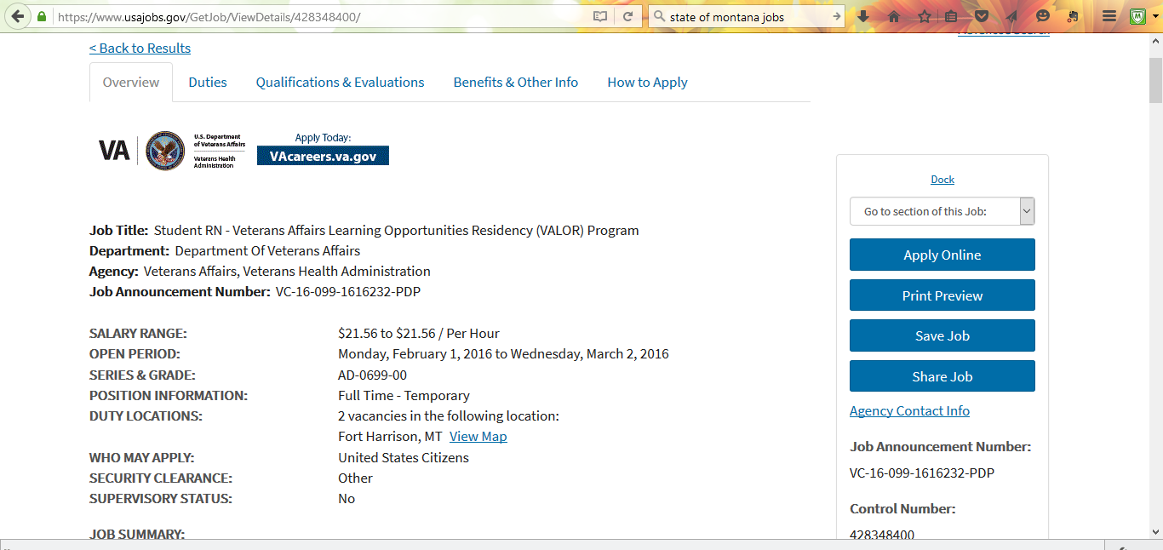

Slide 23
Employment Agencies
www.westaffmt.com
http://www.a2zmontana.com/

Slide 24
Online Employment

Slide 25
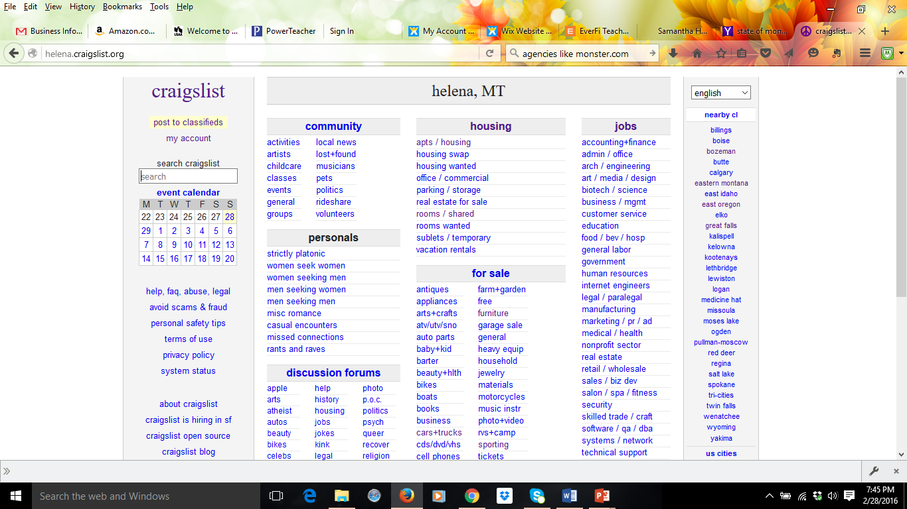

Slide 26
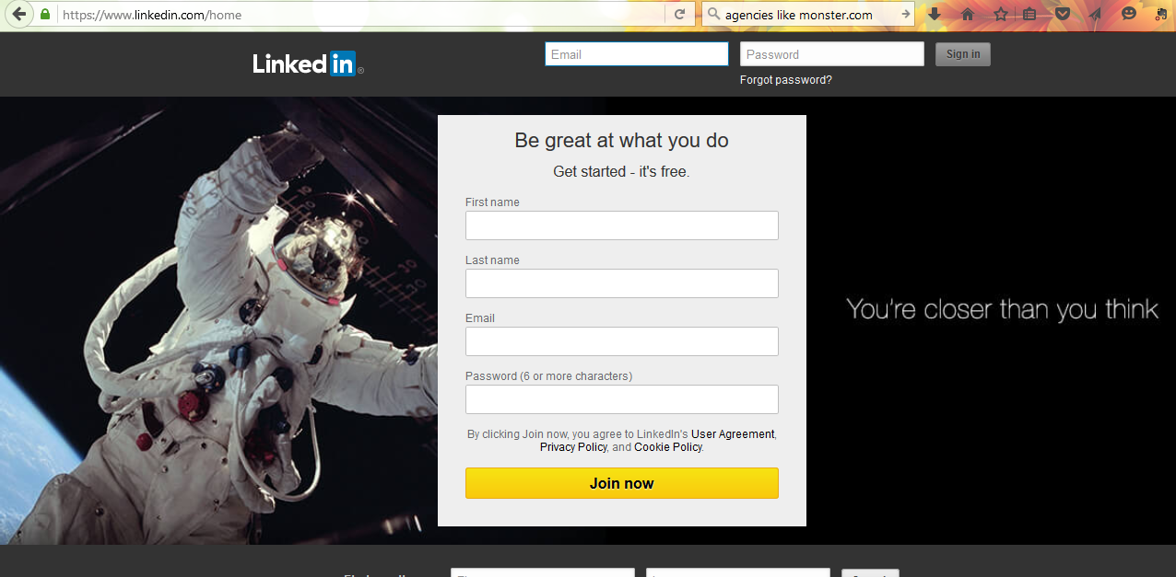
Social Media

Slide 28
Newspaper Classifieds

Slide 29
Cold Calls
From Investopedia: Cold calling typically refers to phone calls but can also entail drop-in visits (or even emails or letters)
Directed at companies you are interested in working for but do not know if a vacancy exists.

Slide 30
Search Tools
State Employment Agency
Specific Agencies, Organizations or Stores
Employment Agencies
Flyers or Signs
Friends and Family
Social Media
Newspaper Classified
Cold Calls

