Slide 1
The Next Step
Educational Options

Slide 2
Understanding the Requirements
On The Job Training
Master’s Degree
Apprenticeship
Professional Degree
Vocational School
Associate’s Degree
High School Diploma
Bachelor’s Degree
Certificate

Slide 4
Degree Progression
Professional Degree
Master’s Degree
Bachelor’s Degree
Associate’s Degree
Apprenticeship
Certificate
High School Diploma
Vocational School
On The Job Training

Slide 5
High School Diploma

Slide 6
Certificates (usually 1 year or less)

Slide 7
Associate’s Degrees (2 Years)

Slide 8
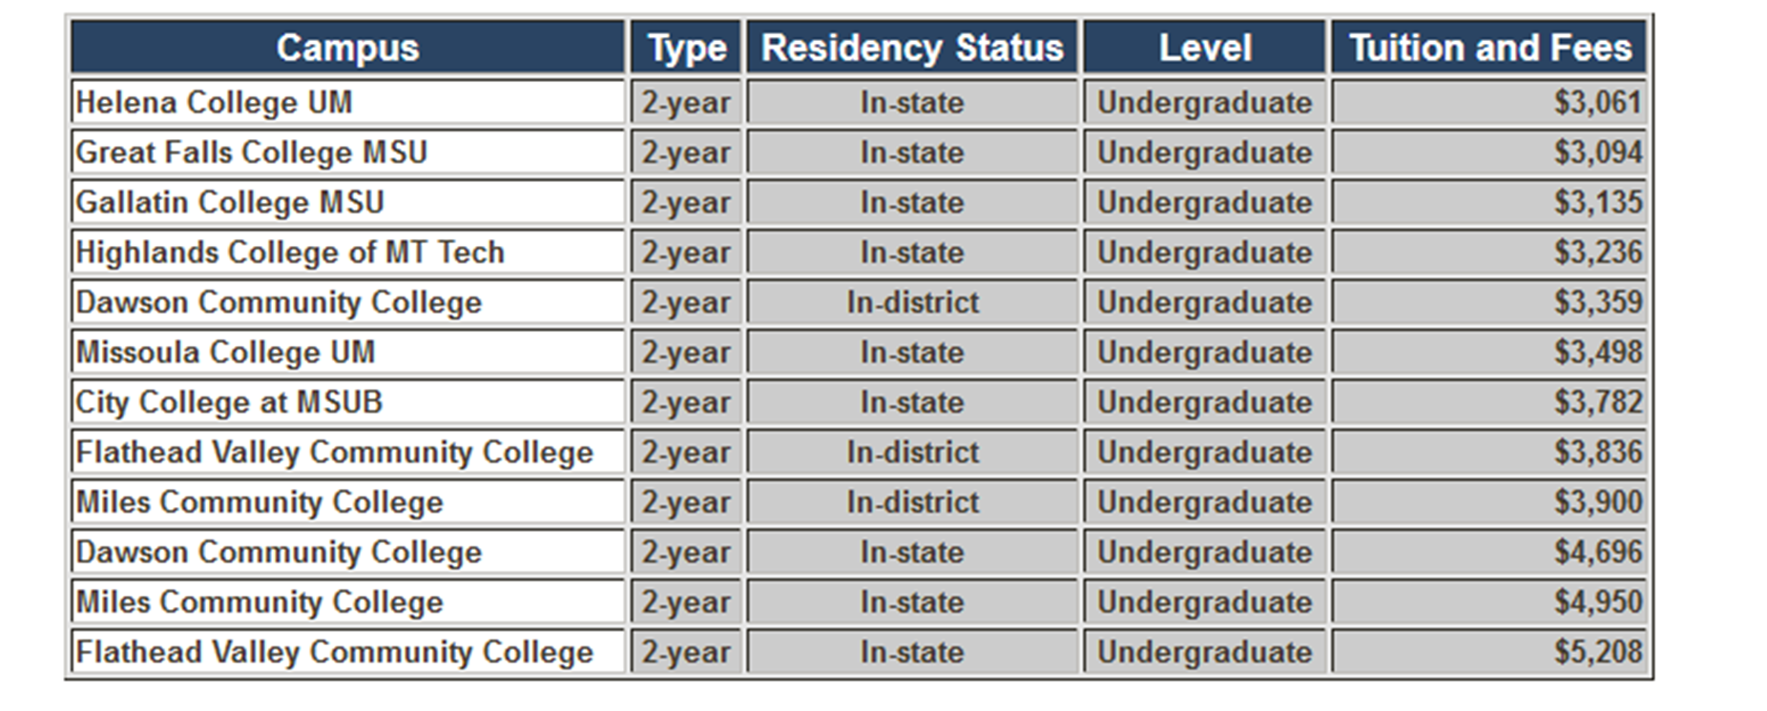
Community or Technical Colleges in Montana

Slide 9
Bachelor’s Degrees (4 Years)

Slide 10
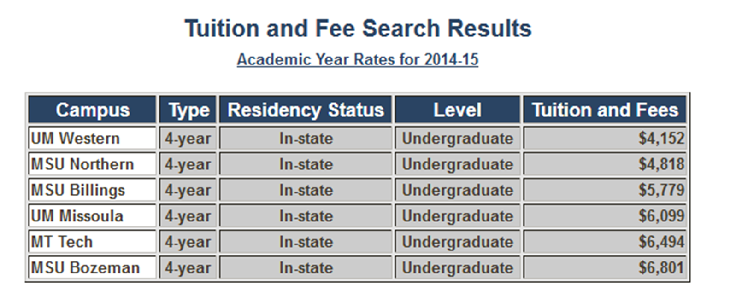
Public Colleges or Universities in Montana

Slide 11
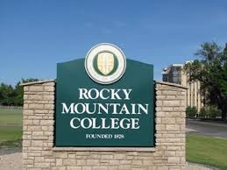
Private Colleges or Universities in Montana

Slide 12
Master’s Degrees (+2 Years after Bachelors)

Slide 13
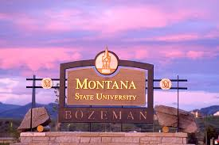
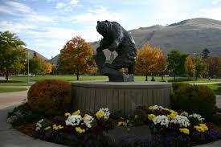
Universities in Montana

Slide 14
Professional Degrees (Time Frame Varies)

Slide 15
Professional Schools in Montana

Slide 16
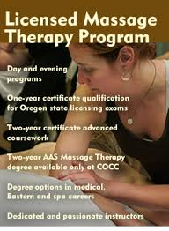
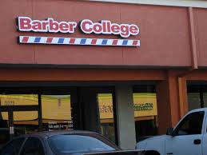
Vocational Degrees (Time Frame Varies)

Slide 17
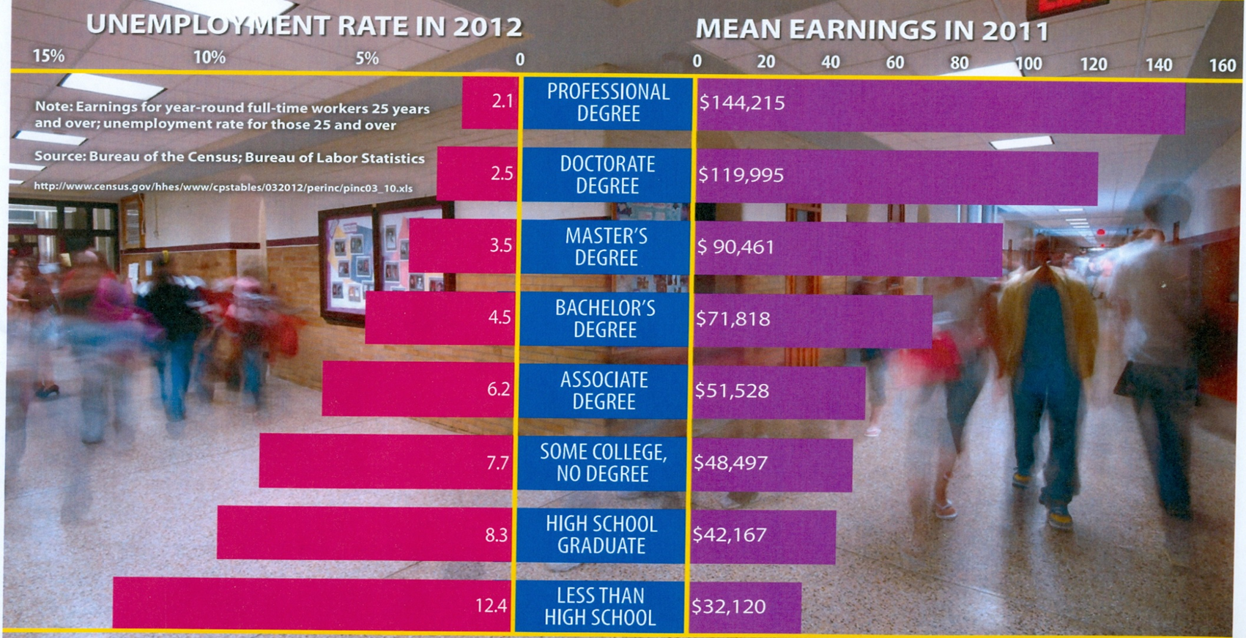
More Education = More Earning Potential

