Slide 1
Credit

Slide 2
Questions
What is credit?
Why is credit important?
What is a credit score?
Credit scores range from what numbers?

Slide 3
What is credit?
Notes:
Student Loans are a form of credit as is borrowing from your parents or your friends. While some may say credit is not necessary it is for many reasons: Some jobs require a good credit score; to rent an apartment sometimes requires a good credit score; a security clearance requires a credit score. Without credit and credit history, a person has to pay in cash or have a sizeable down payment in order to purchase expensive items like a home.

Slide 4
Types of Credit

Slide 5
Questions
What is credit?
Why is credit important?
What is a credit score?
Credit scores range from what numbers?

Slide 6
Why is credit important?
For the United States as a whole, measuring consumer credit tells us important things about our economy. If consumers have the ability to borrow easily and repay those debts on time, then the economy should be stimulated and we will have growth.

Slide 7
Why is credit important?
The 5 Cs of Credit:
How lenders use your FICO score
1. Character 2. Capacity/Cash flow 3. Capital 4. Conditions 5. Collateral

Slide 8
Questions
What is credit?
Why is credit important?
What is a credit score?
Credit scores range from what numbers?

Slide 9
What is a credit score?

Slide 10
Questions
What is credit?
Why is credit important?
What is a credit score?
Credit scores range from what numbers?

Slide 11
Credit Score Range

Slide 12
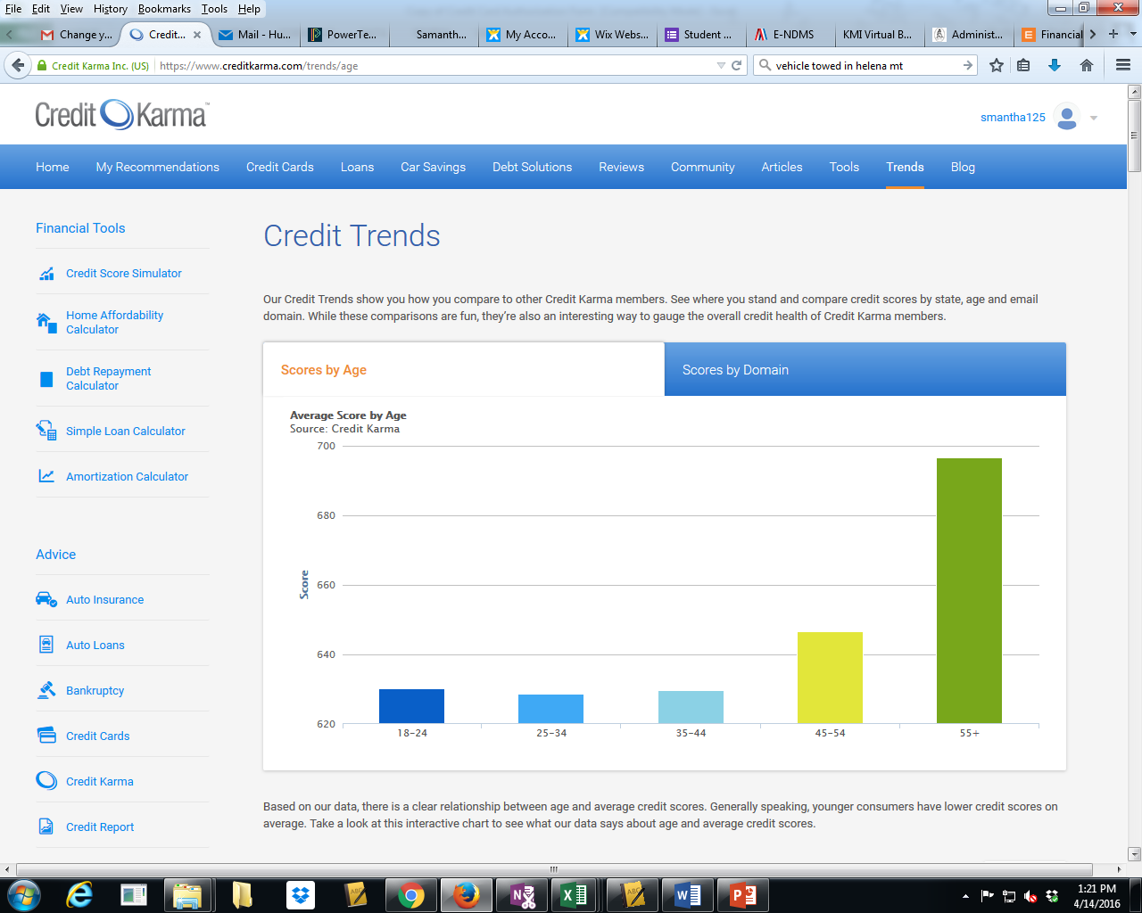
Notes:
Young people just starting out and working on getting a career and/or an education and often don’t have enough money to build credit. Credit dips slight for 25-34 years olds because they often have a lot of student debt they are working on as well as starting families. By 35-44 individuals are establishing themselves, and begin to use credit. By 45-54, they have years of paying back debt and establishing responsible patters and by 55 and older, they have experienced 15-20 years of credit history and are typically more responsible, still working and making the most money than they have ever earned.

Slide 13
Why is your credit score important?

Slide 14
Factors that affect credit scores - Negative
Late Payments
Credit checks (applications)
Negative events like collections, bankruptcy, Consumer Credit help
New Credit
Excessive use of credit (maxed out credit cards)
Closing older accounts

Slide 15
How long dos bankruptcy affect your credit score?

Slide 16
What is Bankruptcy?
Chapter 7
Chapter 13
Chapter 13 is a reorganization bankruptcy designed for debtors with regular income who can pay back at least a portion of their debts through a repayment plan.
In Chapter 13 bankruptcy, you get to keep all of your property (including nonexempt assets). In exchange, you pay back all or a portion of your debts through a repayment plan (the amount you must pay back depends on your income, expenses, and types of debt).
Stays on your credit report for 7 years.
Chapter 7 is a liquidation bankruptcy designed to wipe out your general unsecured debts such as credit cards and medical bills. To qualify for Chapter 7 bankruptcy, you must have little or no disposable income. If you make too much money, you may be required to file a Chapter 13 bankruptcy.
Stays on your credit report for 10 years.
www.nolo.com

Slide 17
Factors that affect credit scores - Positive
On time Payments
Length of credit – the longer the better
Minimal use of credit
Paid off accounts
High credit to debt utilization

Slide 18
Account reported to collections
Notes:
Using a tool like Credit Karma which is free and tracks your credit information and reports it back to you. Here is the simulation program they have to help you make good credit decisions.

Slide 19
Getting a New Loan

Slide 20
Getting a New Credit Card and transferring a balance

Slide 21
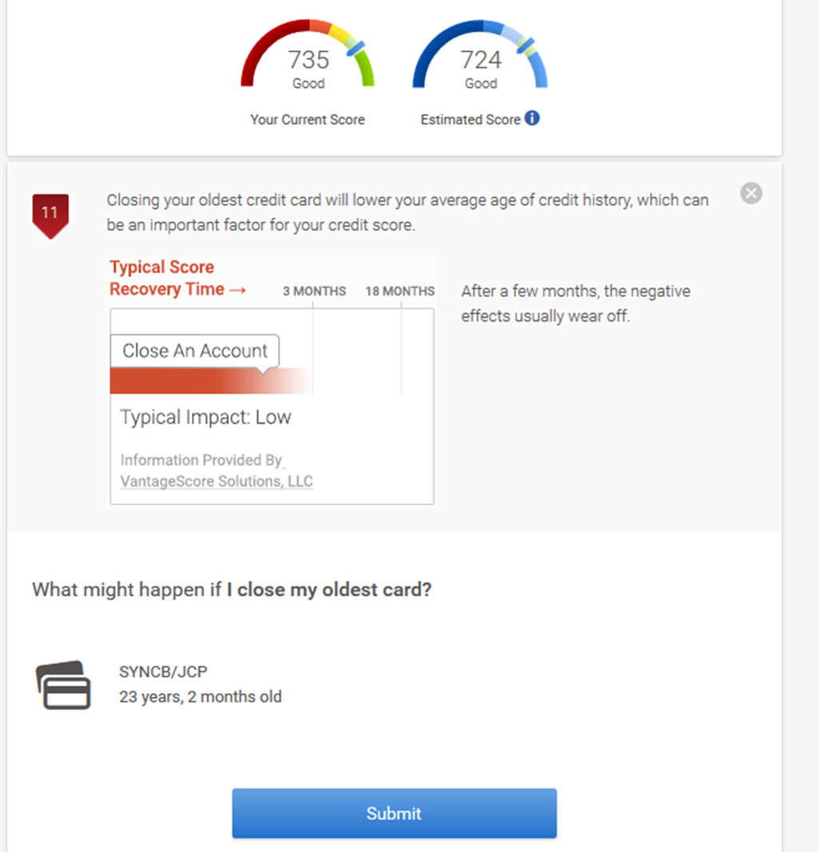
Closing an old account

Slide 22
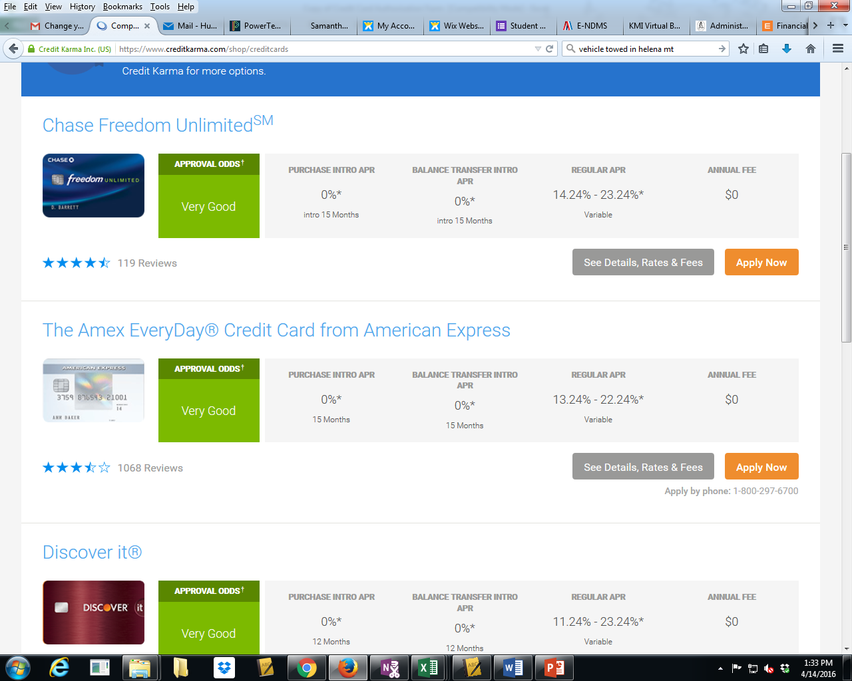
Notes:
Credit Karma can also make recommendations as to what credit cards you have the best chance of getting. It is important to compare rates and not try to apply for more than one at a time. Remember, the number of hard inquiries (which is what happens when a business accesses your credit score) reduces your credit score.

Slide 23
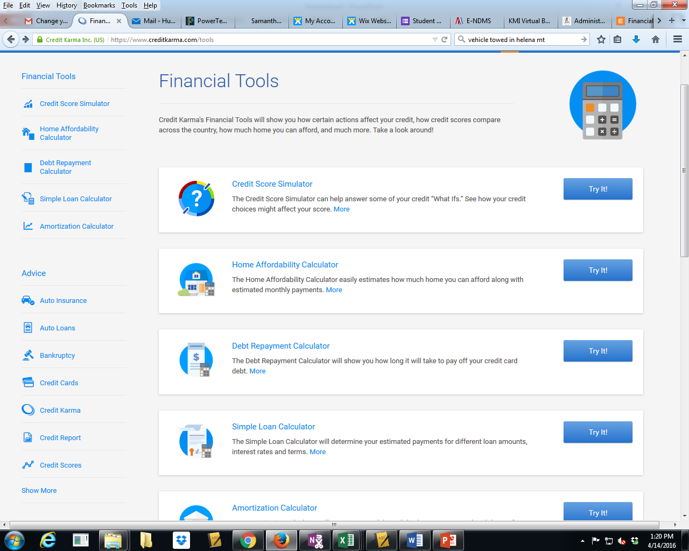
Notes:
Here are other tools available to you through Credit Karma.

Slide 24
Taking care of your credit
Get your free credit report EVERY YEAR. You get one free every year! Be careful not to get scammed though!
Track your credit regularly using sites like Credit Karma.
If you are denied credit, contact the credit bureau used and get another free report. Make sure to make corrections if necessary.
Set up alerts on your debit card and credit cards so you are notified if there are charges above a predetermined amount so you know right away.
Don’t overextend yourself by using too much credit.
Pay your credit bills in full every month.
Notes:
There are a lot of sites that offer “free reports.” Your best bet is to go to the link provided by the FTC – Federal Trade Commission.
If you can’t pay the bill in full, pay more than the minimum but try to get it paid as soon as possible and don’t use it again until it is paid off.

Slide 25
If you are denied credit
It could be because of:
Poor credit history (time, payment history, no or very little credit)
Too much debt already (debit to income)
Too short of a time at a job or at a residence
Poor or irregular work history
Ask bank for a reason
If it is because of your credit history - contact the credit bureau used and get another free report. Make sure to make corrections if necessary.
If it is because of your existing debt - pay off existing debt before reapplying
To build credit history – get a secured credit card
Save to pay part or all of the credit you are asking for.

Slide 26
Correcting Your Credit Report
Step Two
Tell the information provider (that is, the person, company, or organization that provides information about you to a credit reporting company), in writing, that you dispute an item in your credit report.
If the provider continues to report the item you disputed to a credit reporting company, it must let the credit reporting company know about your dispute. And if you are correct — that is, if the information you dispute is found to be inaccurate or incomplete — the information provider must tell the credit reporting company to update or delete the item.
If the information is accurate – only time will erase it.

Slide 27
Correcting Your Credit Report
Step One
Tell the credit reporting company, in writing, what information you think is inaccurate. Use our sample dispute letter. Include copies (NOT originals) of documents that support your position.

Slide 28
Protect Yourself
Avoid Bait and Switch Tactics
Avoid businesses that advertise “No Credit No Problem”
Promises to refinance at a lower rate and a later date usually are just a tactic to get you to finance NOW
Never sign blank loan documents
Never sign a title or a “deed” to get a loan
Ensure the interest rate you are agreeing to is in the loan paperwork
Avoid Payday lenders, Title loans, and Pawn Shops

Slide 29
How to “fix” your credit
Notes:
Pawn shops are allowed, by law, to charge a fee of 25% of the loaned amount per month and 25% to extend the loan for an additional month.

Slide 30
How to “fix” your credit
If you get into a mess with credit, get overextended or you can’t make your payments – DO NOT IGNORE THE PROBLEM! It won’t go away – it will get worse.
Contact the creditor – try to restructure your payments
Try to get another job or find additional sources of income to get back on track
If that doesn’t work……go to a recognized Consumer Credit Counselor for help
If all else fails…bankruptcy might be necessary
Notes:
Remember – the first thing to do is contact the creditor to see what they can do to help you. It costs them money when you default so they are usually willing to help.

Slide 31
How to “fix” your credit
Whatever you do – DO NOT
Use Payday loans or Title loans or pawn shops – the interest they charge will make it even worse
Credit Relief, Credit Repair or Bankruptcy Relief or Tax Relief companies – they cannot do anything you can’t do yourself and it will cost you!!
Get back on track – pay at least the minimum payment and use the snowball method to pay off your debt.
Notes:
Payday loans will cash a check for you and hold it until your payday.

Slide 32
How to “fix” your credit
You can get this short-term loan in 30 minutes. But is it worth the 300% APR?
A title loan is a type of emergency financing that uses your car’s title as collateral. You can get your money in as little as 30 minutes and continue driving your car while paying it back.But be well aware that it comes with high rates and you risk losing your car or getting caught in a cycle of debt if you can’t afford repayments.
Notes:
Payday loans will cash a check for you and hold it until your payday.

Slide 33
How bad can it get?
Creditors can turn your debt over to a Collection Agency
Creditors can take you to court and get a judgement against you
Creditors can repossess any collateral and sell it to help relieve a debt
Creditors can freeze your accounts
Creditors can garnish your wages

Slide 34
How to avoid credit problems
Use credit cards wisely
Only charge what you can pay off each month
Limit the number of credit cards you use
Ignore the allure of free travel miles, or free stars or a discount for opening a card
Set a minimum payment option so in case you forget – at least a minimum payment will be paid
Compare interest rates and shop around
Use cash
Make Extra Payments if possible

